Slide 1
Phase-field simulations to inform nuclear fuel performance modeling
Larry Aagesen
Idaho National Laboratory
Co-authors/Colleagues:
Wen Jiang, Sudipta Biswas, Al Casagranda, Steve Novascone, Kyle Gamble
Idaho National Laboratory
David Andersson, Michael Cooper, Topher Matthews
Los Alamos National Laboratory

Slide 2


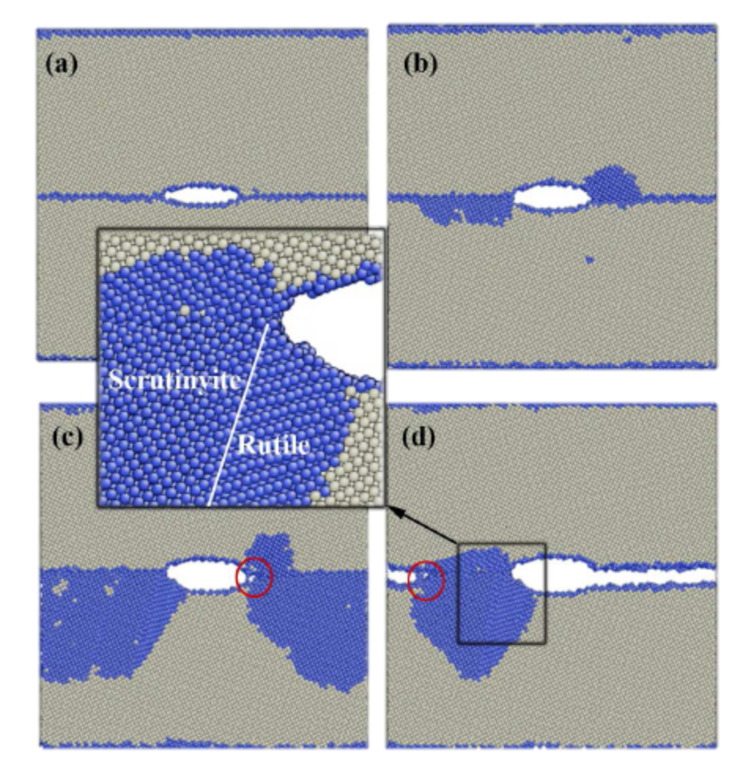
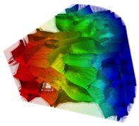
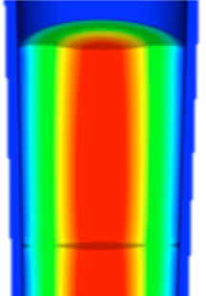
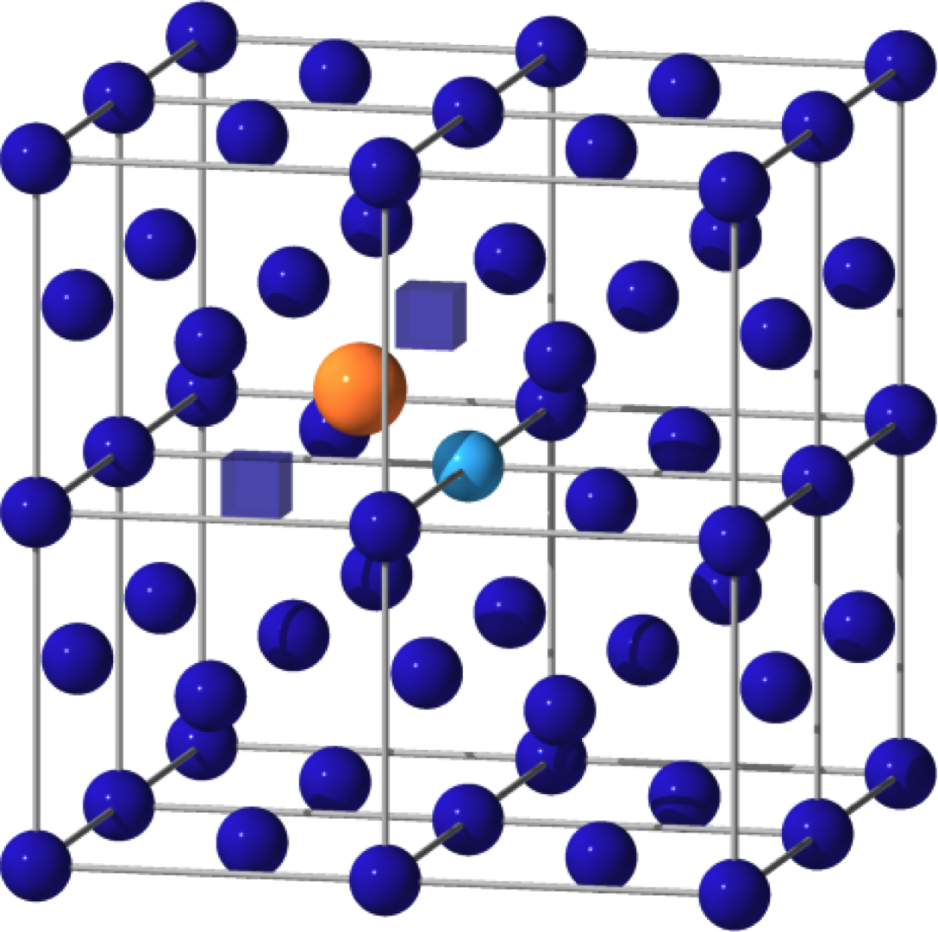



Multiscale fuel performance simulation
BISON: Fuel performance code developed at INL
Inform BISON with atomistic and mesoscale simulations
Marmot: MOOSE-based phase-field simulation code
Analytical theory
nanometers
First Principles
Identify critical bulk mechanisms
Determine bulk properties
100’s of nanometers
Molecular Dynamics
Identify interfacial mechanisms
Determine interfacial properties
microns
Mesoscale
Predict microstructure evolution
Determine impact on properties
millimeters and up
Engineering Scale
Use analytical theory
Predict fuel performance

Slide 3
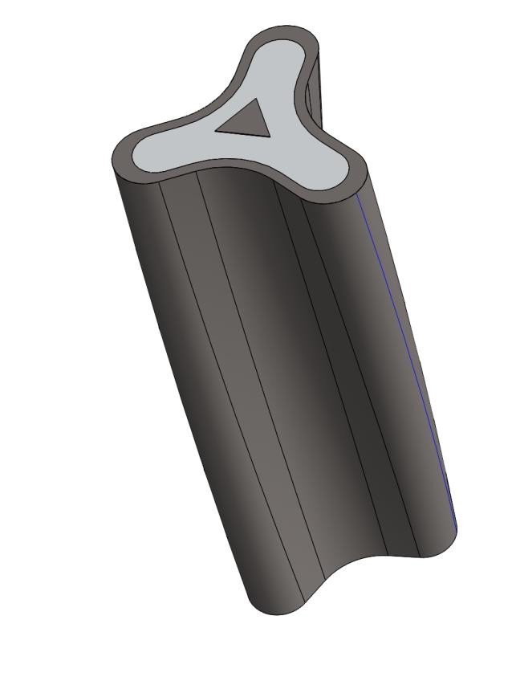
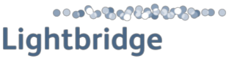
Gaseous swelling in U-(Pu)-Zr fuels
Renewed interest from commercial sector (Oklo Aurora, Lightbridge)
Draw on experience from EBR-II reactor at INL
Fuel pin center: Gamma + (alpha or beta) phase
Gamma-phase swelling and microstructure: Dominated by large fission gas bubbles
Fuel pin periphery: Alpha + delta phases
Swelling primarily due to tearing mechanism
Current BISON models assume swelling and fission gas release by fission gas bubble mechanism (gamma) throughout
Oklo Aurora
Gas bubble microstructure in 𝛾 phase U-Zr fuel
Hoffman & Walters, Metallic Fast Reactor Fuels
Notes:
I’m going to be talking about the work we’ve been doing on the gaseous swelling model
In U-Zr and U-Pu-Zr fuels, in the center portions of the fuel pin the fuel is in primarily in the gamma phase which has the BCC crystal structure
Depending on the temperature there may also be some fraction of the alpha or beta phases
In the gamma phase, the microstructure of irradiated fuels is dominated by large FG bubble such as what’s shown here, and these bubbles dominate the swelling behavior
In the outer periphery of the pin the microstructure is a mixture of the alpha and delta phases which have a lamellar microstructure
The mechanism for swelling in the alpha phase is different, the mechanism seems to be the formation of tears along grain boundaries
The current model assumes assumes swelling is governed by the bubble growth mechanism, so in other words it neglects the tearing mechanism in the alpha phase and essentially assumes all swelling is caused by the FG bubble mechanism
Andrea will talk a little more about how we’re trying to improve on that but the remainder of my talk is going to be focused on the gamma phase

Slide 4
New swelling models added to BISON for U-(Pu)-Zr fuels
UPuZrGaseousEigenstrain: Single equation analytical model
Gaseous swelling:
T = temperature
𝛾 = surface energy of bubble-solid interface (have this from lower length scale)
Y_{Xe} = gaseous fission product yield
F = fission rate density
t = time
N = number density of bubbles (estimated from experimental data)
Fundamental Aspects of Nuclear Reactor Fuel Elements (Olander)
Notes:
This year a new swelling model was added to Bison
This is a very simple textbook model to start out with but it performs much better numerically. Al will talk a little later about the assessment he did on the model
The physical parameters that are needed are shown here
Ben Beeler did some calculations to determine surface energy
The only other parameter that is not well knownis the number density of bubbles. So Al and I came up with an estimate of this based on some prior experimental data, but this is something we hope to improve on in the future.
The model currently assumes that the bubble number density remains constant which is likely incorrect, so this is another area that we plan to improve on in future work
\left(\frac{\Delta V}{V_0}\right)_g = \left( \frac{3}{4\pi} \right)^{1/2} \frac{[(kT/2\gamma) Y_{Xe} \dot{F} t]^{3/2}}{N^{1/2}}

Slide 5
Threshold for gas release in UPuZrGaseousEigenstrain
Swelling occurs until porosity is high enough to allow gas release
Swelling tapers off linearly in range from p_{i} < p < p_{t}
p_{i} = interconnection initiating porosity
p_{t} = interconnection terminating porosity
Fraction of gas released increases linearly in same range
Previous estimate of p_{t} = 0.25 porosity (33% swelling) based on analytical estimate (Barnes, JNM, 11, 2, 135-148, 1964). p_{i} was chosen at 0.23 for model performance rather than physical grounds
Goal: Develop improved estimates of gas p_{i} and p_{t} by simulating percolation of growing fission gas bubbles
Notes:
So that analytical equation is used to determine the gaseous contribution to swelling up until the point when porosity is high enough that the bubbles become an interconnected volume that connects to the free surface and gas gets released from the fuel
So the current Bison model assumes a maximum of 25% porosity (eq, 33% swelling), which comes from an analytical estimate by Barnes; which has a lot of assumptions inherent in it
And the swelling gradually tapers off in the range from 23% to 25%, which are adjustable parameters in Bison
The reason for that gradual decrease in swelling from 23% to 25% is not due to physical reason but it’s primarily there to improve numerical performance compared with turning it off suddenly at 25%
So this is one of several high-priority assumptions in the swelling model to be addressed, but it was also recently brought to our attention that the threshold for gas release was of major interest to Oklo in their process of certification by the NRC
So we decided for both of these reasons to attempt to develop improved estimates of the gas release threshold and the maximum swelling by simulating the percolation of growing fission gas bubbles

Slide 6
Phase-field simulation of growing gas bubbles
Large 3D simulations required to get good statistics, so start with the simplest model possible
Cahn-Hilliard model, single defect species with source term for production in the solid
Free energy with minima at normalized defect concentrations c = 0 and c = 1
Notes:
In order to do that we’re going to use phase-field simulations
So in order to do these simulations and get good statistics we knew we would need to do 3D simulations with a large numbers of particles, so they would be computationally demanding
So we wanted to start with the simplest model possible
So we decided to use a Cahn-Hilliard type model that would allow us to represent the microstructure with a single defect species
We then introduced a source term for the defect species in the solid matrix surrounding the bubbles
The free energy is a simple double well with minima at normalized concentrations at 0 and 1
In the initial conditions, we randomly placed spherical isolated bubbles with the number density determined from experiment that I mentioned before
We start at 5% volume fraction of bubbles in IC, from which we set the initial bubble size
We used the interfacial energy determined from Ben Beeler’s calculations

Slide 7
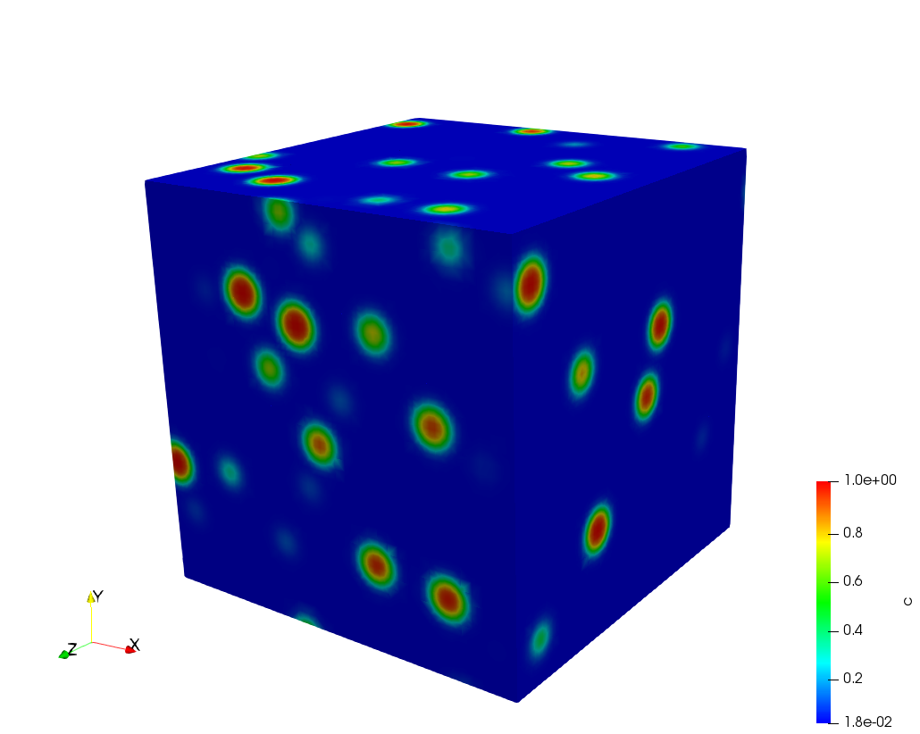
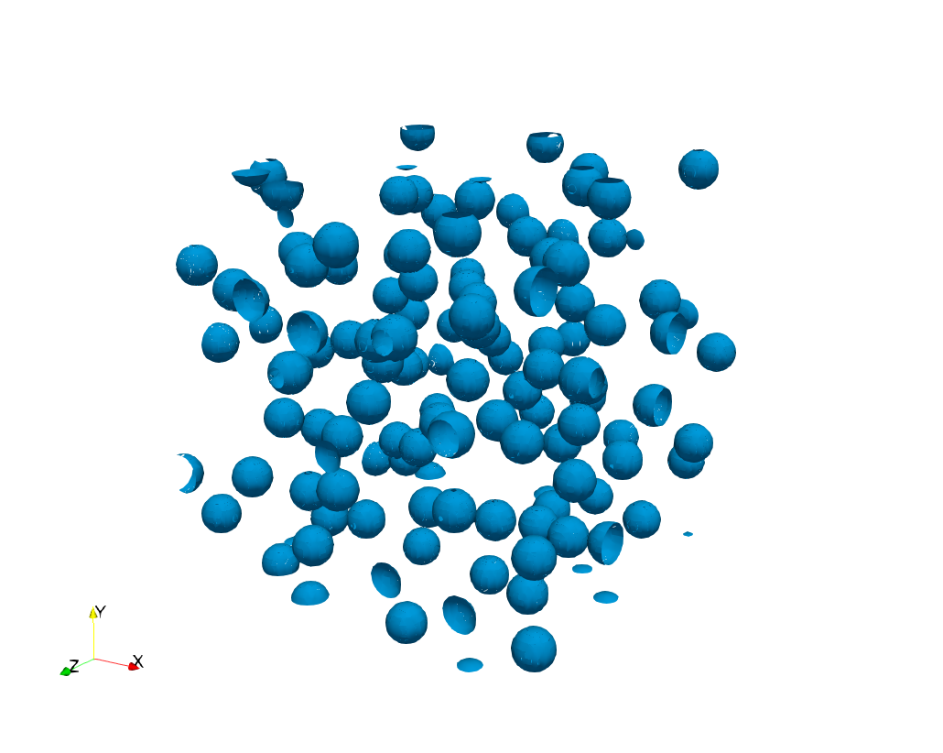
Phase-field simulation of growing gas bubbles
Initial conditions: Randomly placed isolated bubbles at N = 3 ⨉ 10¹⁴/m³, as determined from experiment
Interfacial energy 1.8 J/m² from atomistic calculations
Diffusivity not well known, so vary parametrically with fixed source strength to see effect
Initial conditions, simulation volume (72 μm)³
c = 0.5 contour
Notes:
In order to do that we’re going to use phase-field simulations
So in order to do these simulations and get good statistics we knew we would need to do 3D simulations with a large numbers of particles, so they would be computationally demanding
So we wanted to start with the simplest model possible
So we decided to use a Cahn-Hilliard type model that would allow us to represent the microstructure with a single defect species
We then introduced a source term for the defect species in the solid matrix surrounding the bubbles
The free energy is a simple double well with minima at normalized concentrations at 0 and 1
In the initial conditions, we randomly placed spherical isolated bubbles with the number density determined from experiment that I mentioned before
We start at 5% volume fraction of bubbles in IC, from which we set the initial bubble size
We used the interfacial energy determined from Ben Beeler’s calculations

Slide 8
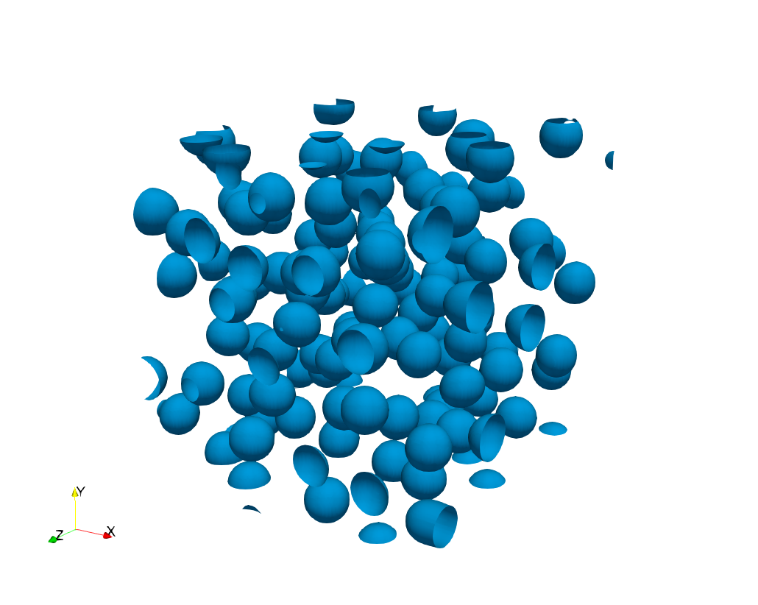
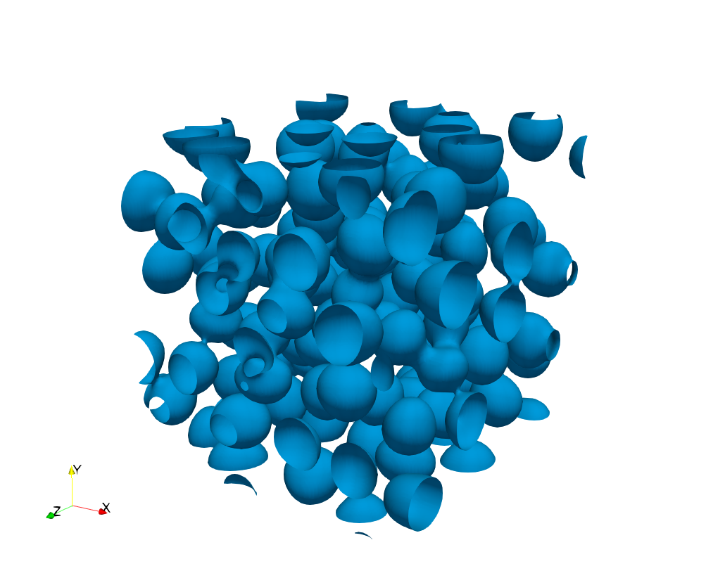
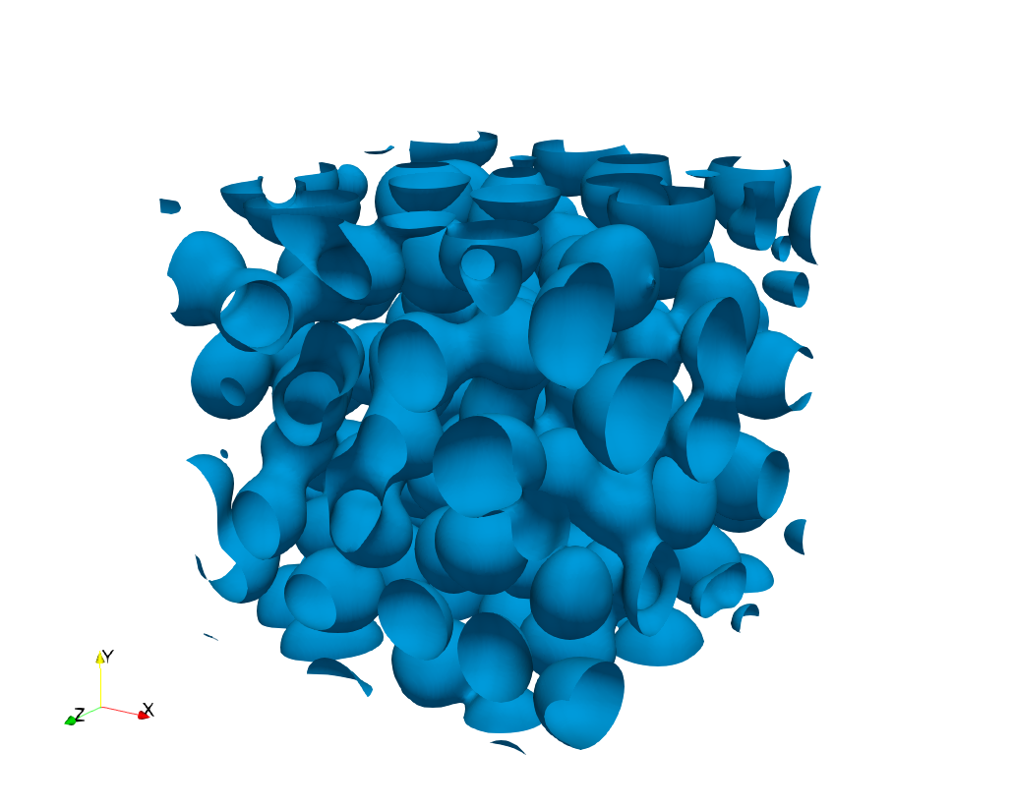
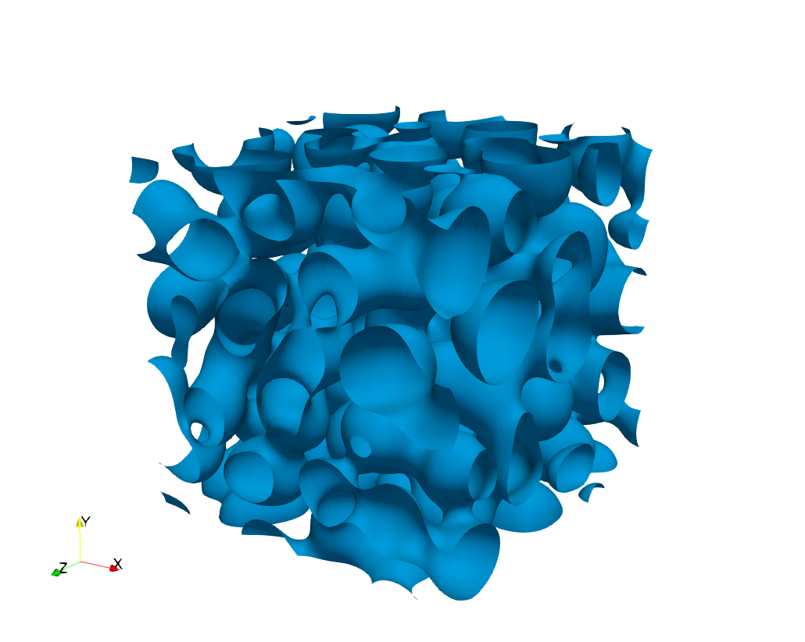
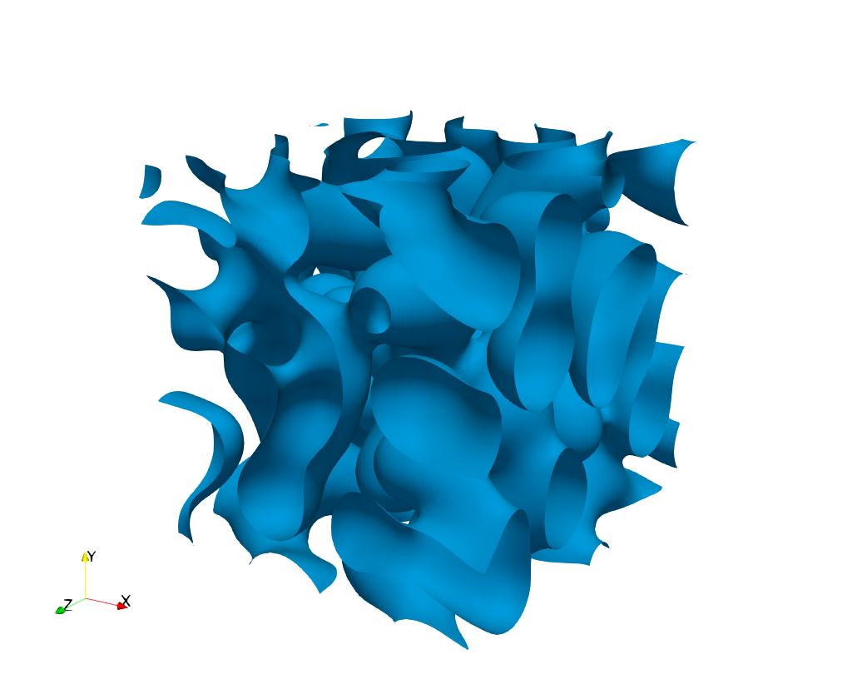
Phase-field simulation results
(72 μm)³ domain, 112 bubbles for N = 3 ⨉ 10¹⁴/m³
Time evolution for D = 2 nm²/s:
Effect of diffusivity on morphology:
D = 2 nm²/s, t = 1.14 × 10⁸ s
D = 10 nm²/s, t = 1.14 × 10⁸ s
Notes:
So the simulation domains were cubes with an edge length of 72 microns
We started out looking at 112 bubbles to give us the number density of …
We kept the same source strength and varies the CH mobility which is proportional to diffusivity
Play both movies, finish at the same time
At the end if you look at the higher mobility case hopefully you can see that the microstructure is coarser for the higher mobility case and finer for the low mobility case
But it’s a little hard to see what’s going on so we tried to quantify the microstructural evolution

Slide 9
Connectivity to surface
Fraction vented to surface as a function of porosity
Percolation threshold (p_{c}) for each mobility
Vented: Connected to this surface (x = 72 μm, no-flux BC)
Percolated: One or more bubbles connects these faces
D = 2 nm²/s
Notes:
OK so now to link these results to Bison we want to look at the connectivity of the bubbles to a free surface
So we’ve used no-flux BCs for the x direction and periodic BCs for y and z
What we’re going to do is plot here what fraction of the bubbles are connected to that free surface as a function of the porosity
But even though this domain is a lot larger than the size scale of the bubble, it’s still much smaller than the size of a pellet
So to determine the porosity at which gas is free to flow through the domain, we also determined the percolation threshold, which is the porosity at which there’s a continuous pathway through one or more bubbles that connects these two faces
Figure: frame 20, t = 76.2 from 190819a

Slide 10
Percolation threshold
Determined percolation threshold p_{c} for each mobility
D = 2 nm²/s
p_{c} = 0.264
D = 5 nm²/s
p_{c} = 0.253
D = 10 nm²/s
p_{c} = 0.276
Notes:
So we determined the pc for each mobility and plotted those against the venting curves
Pc was in the range 0.25 to 0.28 so it didn’t vary a significant amount
Additionally there wasn’t an obvious trend with mobility so at least for the range of mobilities we could look at it doesn’t seem that mobility was a strong factor
Figure: frame 20, t = 76.2 from 190819a

Slide 11
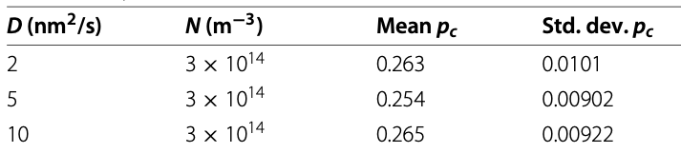
Varying initial conditions to obtain improved statistics and quantify uncertainty
Generated multiple random bubble distributions for initial conditions
D = 2 nm²/s
D = 5 nm²/s
D = 10 nm²/s

Slide 12
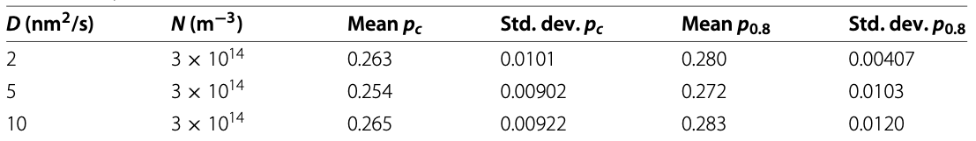
Determining parameters for Bison U-(Pu)-Zr swelling model
Assume no significant gas release can occur from interior regions of fuel until percolation threshold is reached
Set p_{i} = mean p_{c} = 0.262
Based on EBR-II post-irradiation examination, fission gas release plateaued at 80% of fission gas produced
Define p_{0.8} as the porosity at which f_{V} = 0.8
Set p_{t} = mean p_{0.8} = 0.28
Notes:
So then to determine the Bison parameters for the swelling model, I think it’s reasonable to assume there’s no gas release until the percolation threshold is reached
So if we use the median value of the simulations we should set the interconnection_initiating_porosity to 0.26 (increase from 0.23)
To determine the interconnection_terminating_porosity, we’re going to use the fact that EBR-II PIE showed gas release plateaued at a maximum of 80%
So we’ll find the porosity at which 80% of the bubbles are connected to the free surface, which similarly to pc didn’t vary strongly with mobility
So based on this median case we set interconnection_terminating_porosity to 0.28 (increase from 0.25)

Slide 13
BISON fission gas release prediction from simulated EBR-II fuel pin
Optimization was performed using Dakota to determine model parameters that best matched experimental measurement of FGR
Results were strongly dependent on initial guesses for parameters
Using values of p_{i} and p_{t} from phase-field simulations significantly reduced the dependence on initial guesses for other parameters
Fit p_{i} and p_{t}
p_{i} and p_{t} from phase-field

Slide 14
Conclusions and next steps
Determined improved parameters for BISON model UPuZrGaseousEigenstrain
Results fairly consistent for varying defect species mobility (over limited range considered)
Higher initial bubble density pushed percolation and venting earlier
Further efforts to quantify this parameter (experiment and simulation) for a variety of fuel compositions and operating conditions
More advanced swelling model development in progress (considers more realistic gas equation of state, effect of hydrostatic stress, more realistic interconnectivity function)
Same simulations are being analyzed to parameterize this model

Slide 15
Parameterization of BISON model for fission gas release in U₃Si₂ nuclear fuel using phase-field simulations
Larry Aagesen¹, David Andersson², Benjamin Beeler³, Michael W.D. Cooper², Kyle Gamble¹, Yinbin Miao⁴, Giovanni Pastore⁵, Cody Permann¹, Michael Tonks⁶
¹Idaho National Laboratory
²Los Alamos National Laboratory
³North Carolina State University
⁴Argonne National Laboratory
⁵University of Tennessee
⁶University of Florida

Slide 16
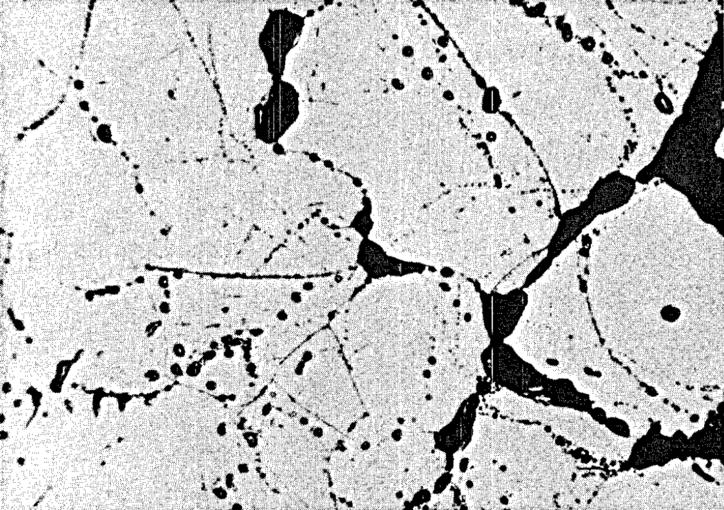
U₃Si₂ is being considered as a potential accident-tolerant fuel
Compared with UO₂:
Lower melting temperature
But higher thermal conductivity may give higher margin to melting temperature
U₃Si₂ swelling/fission gas release behavior less well characterized
Evidence from higher-temperature irradiation suggests pellet-form fuel would remain crystalline, have similar microstructure as UO₂ fuel
BISON model recently developed based on these assumptions
U₃Si₂ implanted with Xe at 873 K (Miao et al., J. Nuclear Mater., 503, 314-322 (2018).
U₃Si₂ irradiated at ~950 K and ~6 GWd/tU (Shimizu, NAA-SR-1062, 1965).
Barani et al., J. Nuclear Mater., 522, 97-110 (2019).
Notes:
There has been a renewed interest in recent years in using U3Si2 as a fuel for commercial LWRs due to it potentially better performance in accident scenarios
Compared with UO2 it does have a lower melting temp.
But it does have a significantly higher thermal conductivity, which it’s believed will give a higher margin to the melting temp in accident scenarios
However the swelling and fission gas behavior of U3Si2 is not nearly so well understood as in UO2,
Although there is a lot more data on U3Si2 operating as a dispersion fuel at low temps in research reactors, there is a lot less data on U3Si2 at higher temperatures such as would be experienced in a commercial LWR
However the data that is out there at higher temps suggests that the fuel remains crystalline rather than amorphizing,
The microstructure also seems to be similar to UO2 fuel, where you have a polycrystalline microstructure with intragranular fission gas bubbles within the grains that are very small, with diameters on the order of nm
And you also have intergranular or GB bubbles that are much larger, on the order of hundreds of microns
So based on these assumptions on the microstructure, in order to predict the performance of U3Si2 fuel in pellet form in commercial LWRs, a model was recently developed in INL’s engineering fuel performance code, BISON

Slide 17
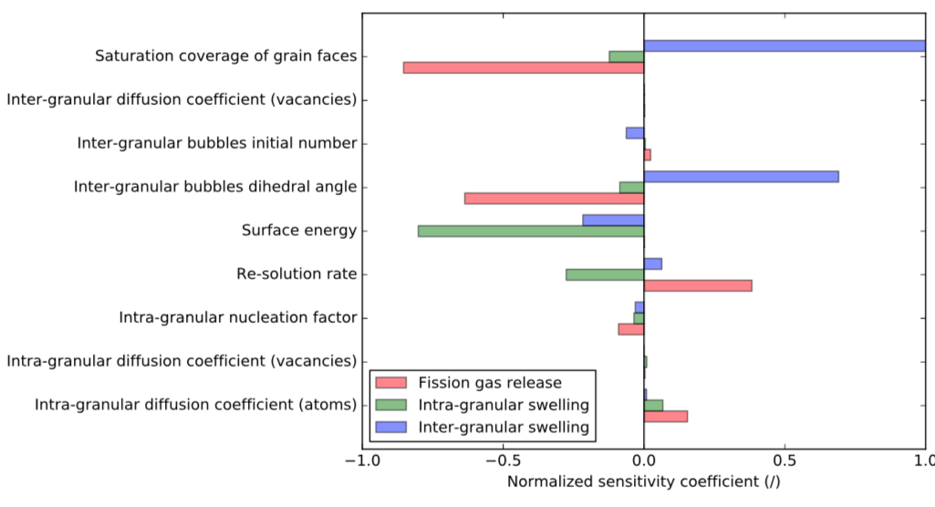
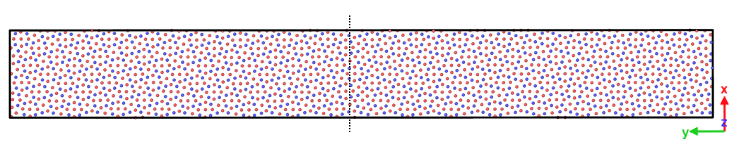
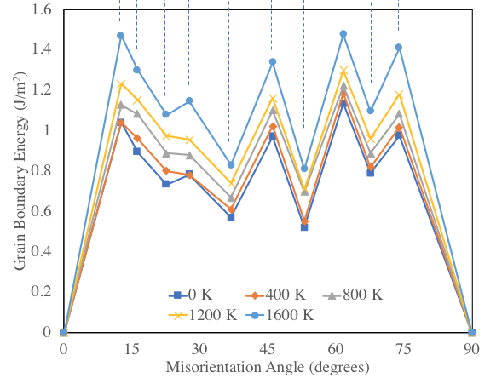
Lower length scale calculations to reduce uncertainty in BISON
Configuration for MD Calculation of GB Energy
Sensitivity analysis of BISON U₃Si₂ swelling and gas release predictions showed strong dependence on inter-granular bubble dihedral angle and surface energy
Measured values also not available
Surface energy and grain boundary energies were determined for U₃Si₂ using molecular dynamics (MD) calculations
Dihedral angle (θ) calculated from surface energy and grain boundary energy; input to BISON
Data also used to parameterize Marmot model
Beeler, Baskes, Andersson, Cooper, Y. Zhang, J. Nucl. Mater., 514, 290-298 (2019).
Notes:
As part of the development of that model they did a sensivitity analysis of the factors that affect FGR and swelling
Because there isn’t much data available on U3Si2, many of the parameters needed for the model aren’t well known
So what we wanted to do was to use the sensitivity analysis t to guide us toward the most important parameters to focus on with LLS calculations
So a few of the parameters that had the greatest impact were the bubble dihedral angle and…
These are parameters for which measured values aren’t available
But thanks to the work done by Ben Beeler and others we have an interatomic potential that could be used to calculate these parameters by MD
So the surface energy is calculated with this potential at varying temps. And input to Bison
Ben also calc the GB energies and those with the surface energies determine the bubble dihedral angle
So in addition to using those quantities directly in BISON we’re also using this data to parameterize the Marmot phase-field model

Slide 18
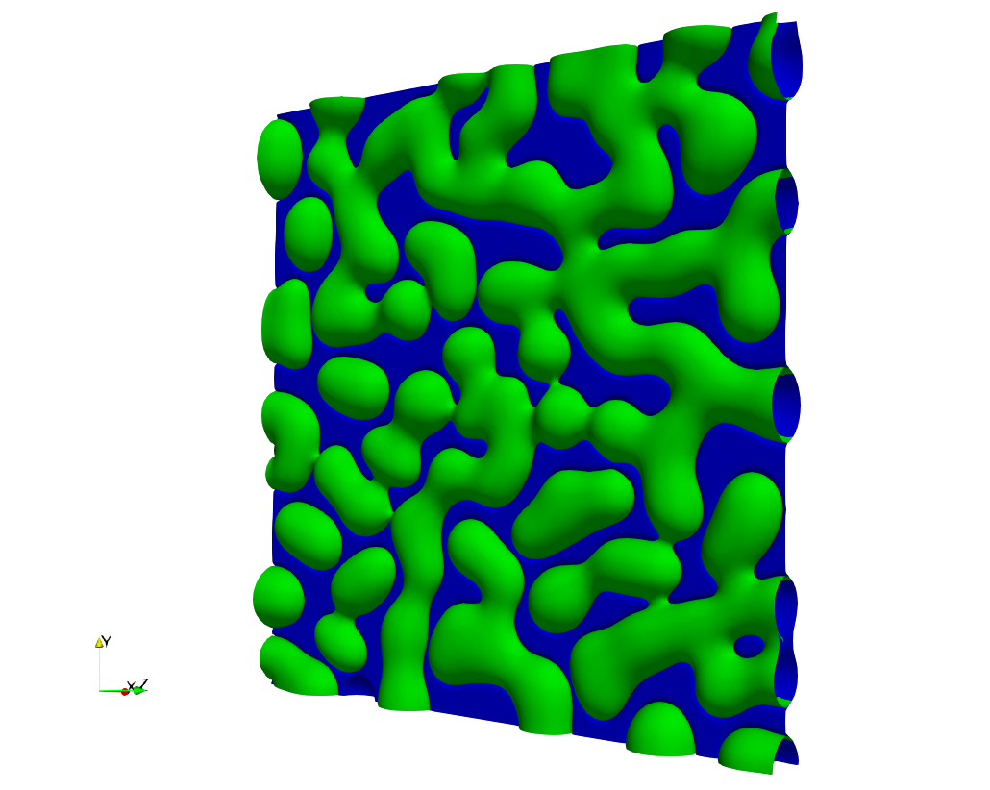
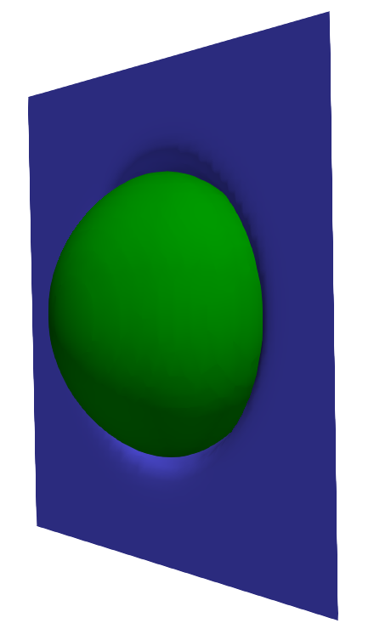

Lower length scale calculations to reduce uncertainty in BISON
Sensitivity analysis also showed strong dependence on saturation coverage of grain faces (F_{c,sat})
No measured value available for U₃Si₂
Phase-field simulations¹ showed progress of grain boundary venting was strongly dependent on intergranular bubble areal density and dihedral angle
New phase-field simulations are being used to determine F_{c,sat} using U₃Si₂ parameters
¹Millett, Tonks, Biner, L. Zhang, Chockalingham, Y. Zhang, J. Nucl. Mater., 425, 130-135 (2012).
Notes:
So another factor that the sensitivity analysis found strongly impacted the swelling and FGR predictions was the saturation coverage of grain faces
So what that terms means, essentially the Bison model assumes that the intergranular or GB bubbles grow until they reach a certain fractional coverage, at which point all the gas is released and swelling stops. This is referred to …
So this value has been estimated at about 50% based on empirical measurements in UO2 but it hasn’t been determined for U3Si2. Based on that lack of data Kyle and Giovanni were using a value of 78% based on the theoretical value for a square lattice
So there was some past work done in our group that looked at the progress of venting of GB bubbles parametrically in UO2
A couple of the factors that they found really strongly affected the rate of venting were the bubble areal density and dihedral angle
Because this parameter has such a strong impact, we also wanted to calculate it with the U3Si2 parameters using a new model that has been developed since this previous work that incorporates some additional physics

Slide 19
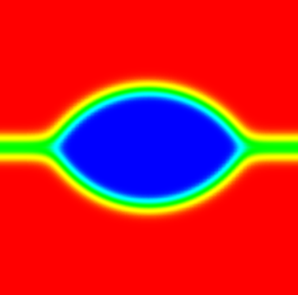
Phase-field model: Essential physics
Represent bubble phase and multiple grains of U₃Si₂
Track vacancies and fission product species (Xe only)
Source terms for production
Set surface energy and grain boundary energy
Controls dihedral angle θ
Remove bulk energy contribution to interfacial energy
Grain 1
θ/2
GB
Bubble
Grain 2
Notes:
So just to summarize the physics that this new model incorporates
We need to represent the bubble phase and multiple grains of the fuel
We want to track U vacancies and fission product species separately and include source terms for their production
We’re going to assume the gaseous fission product behavior can be approximated by the properties of Xe
To capture the morphology of the bubbles we need to be able to set the surface energy of the bubbles and the GB energy based on the MD calculations I mentioned earlier
The ratio of these energies controls the semi-dihedral angle theta of the bubbles
In order to easily parameterize the model, we would like to be able to remove the bulk energy contribution to interfacial energy (similar to KKS)

Slide 20
Phase-field model: Grand-potential functional
Multi-phase, multi-order parameter extension to grand-potential model
Advantages:
Bulk free energy contribution is removed from interfacial energy
Allows interfacial thickness and energy to be set independently, enabling coarser mesh, improved computational performance
Similar to KKS in this respect, but do not need separate phase concentration variables, so performance is improved
Prevents spurious formation of additional phases at two-phase interfaces
L.K. Aagesen, Y. Gao, D. Schwen, K. Ahmed, Phys. Rev. E, 98, 023309 (2018).
L.K. Aagesen, D. Schwen, M.R. Tonks, Y. Zhang, Comp. Mat. Sci., 161, 35-45 (2019).
Notes:
The model is based on a functional of the grand potential density
it’s based on a multi-phase, multi-op extension to the grand-potential model originally developed by Plapp
It has some nice features: it allows us to remove the bulk energy contribution to the interfacial energy. That makes it easier to parameterize
That also allows us to decouple the interfacial energy from the interfacial thickness, which means we can use a wider interface and therefore a coarser mesh, which improves performance
It’s similar in that respect to the KKS phase-field model, for those who might be familiar with that model, but we don’t need separate phase concentration variables as in the KKS model, so its performance is improved
It prevents the spurious formation of additional phases at two-phase interfaces, which is a problem that plagues many other multi-phase field models

Slide 21
Phase-field model evolution equations
Order parameters: Allen-Cahn
Densities: Change to chemical potential for each species
Gas:
Vacancies:
Notes:
So for the evolution equations for the model are derived from the grand potential functional I showed in the previous slide
we have an AC equation for each OP
Then for the densities of each defect species, we change to an evolution equation for the chemical potential of each species
So we have a term incorporating the diffusion coefficients which we take from Cooper’s calcs
And these source terms represent defect production, and we’re using the simplifying assumption that we have a net vacancy production rate rather than tracking interstitial and vacancy production and recomb.
\frac{\partial \mu_g}{\partial t} = \frac{1}{\chi_g} \left[ \nabla \cdot \left(D_g \chi_g \nabla \mu_g \right) + s_g - \sum_\alpha \sum_{i=1}^{p_\alpha} \frac{\partial \rho_g}{\partial \eta_{\alpha i}} \frac{\partial \eta_{\alpha i}}{\partial t}\right]
\frac{\partial \mu_v}{\partial t} = \frac{1}{\chi_v} \left[ \nabla \cdot \left(D_v \chi_v \nabla \mu_v \right) + s_v - \sum_\alpha \sum_{i=1}^{p_\alpha} \frac{\partial \rho_v}{\partial \eta_{\alpha i}} \frac{\partial \eta_{\alpha i}}{\partial t}\right]
\frac{\partial \mu_i}{\partial t} = \frac{1}{\chi_i} \left[ \nabla \cdot \left(D_i \chi_i \nabla \mu_i \right) + s_i - \sum_\alpha \sum_{i=1}^{p_\alpha} \frac{\partial \rho_i}{\partial \eta_{\alpha i}} \frac{\partial \eta_{\alpha i}}{\partial t}\right]

Slide 22
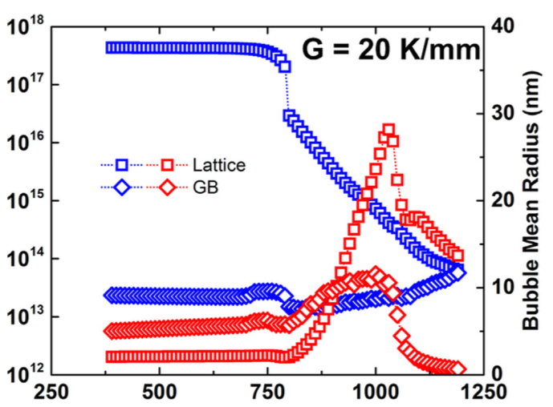
Phase-field model initial conditions
Intergranular bubble areal density (n_{a}): Determine from rate theory simulations
At 1035 K, n_{a} = 15 / μm²
Y. Miao, K.A. Gamble, D. Andersson, B. Ye, Z.-G. Mei, G. Hoffman, A.M. Yacout, Nucl. Eng. Design, 322, 336-344 (2017).
Notes:
As I mentioned earlier the bubble areal density was one of the factors that strongly affected the progress toward venting for the intergranular bubbles
So to set the initial conditions for the phase-field simulations of U3Si2, we needed as good a value as possible
So to get that I took data from Yinbin’s rate theory simulations and with his help converted the reported data to areal density
We’ll be conducting simulations at 1035 K which is representative of the temp near the center of the fuel at high power
So at that temp there were 15/micron^2

Slide 23
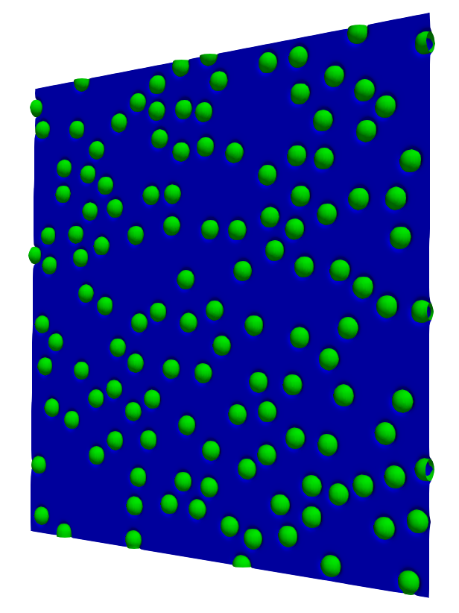
Phase-field model initial conditions
Determine F_{c,sat}
1035 K
𝛳/2 = 73
No-flux boundary conditions
3 μm ⨉ 3 μm grain boundary
Populate with randomly placed lenticular bubbles, n_{a} = 15 / μm², minimum spacing 160 nm
3 μm ⨉ 3 μm
Notes:
To determine Fc,sat we are going to simulate the growth of bubbles with U3Si2 parameters starting at a representative temp of 1035K
This 3 by 3 micron domain corresponds to the grain size we will use for determining Fc,sat. Although we don’t expect that physical grain boundaries are square like this domain, we think that if the domains are large enough compared to the spacing between bubbles it probably won’t affect the results too much. I’ll show some simulations later where we verified that assumptions
For the initial conditions, we populate the GB with randomly placed bubbles at the density determined from rate theory sim.
We set initial spacing between bubbles in IC’s at 160 nm, I’ll say a little more about the impact of that value later
usi190718a

Slide 24
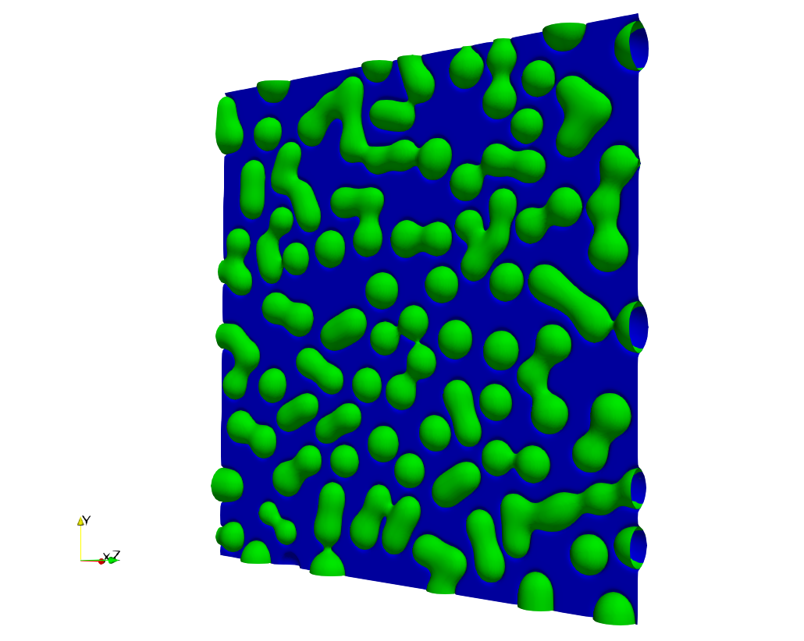
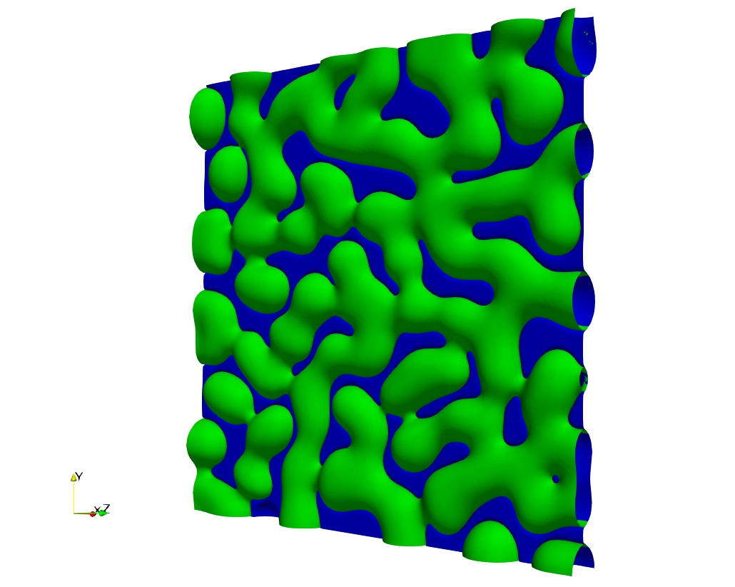
Phase-field simulation results
t = 0
t = 6.04 × 10⁷ s
t = 1.62 × 10⁸ s
t = 1.97 × 10⁸ s
Notes:
Show results for this IC
See bubbles begin to grow, then begin to interconnect with each other and also connect to the boundaries
In the end all of the bubbles are connected to the boundary

Slide 25
Phase-field simulation results
Plot fractional coverage of GB (X_{GB}^{C}) and fraction of bubbles that are vented to edge of domain (X_{GB}^{V}) vs. time
Less rapid increase with respect to time compared to previous simulations of Millett et al., due to to slow buildup from source terms
Areal density of bubbles vs. time
Rate of coalescence relatively constant until the bubble density reaches approximately half its initial value, then slows
Notes:
So, we quantified the results of the simulations in a couple of different ways
The first was to plot the fractional coverage of the grain boundaries by bubbles as a function of time (blue) as well as the fraction of bubbles that are vented to the edge of the domain vs time. So when the bubbles are connected to the edge of the domain we assume they connect to a triple junction network at the GB edges and through that are vented to a free surface
So if you compare this to the previous work that was done by Millett and co-authors the rate of increase with time is much slower. This is just due to the fact that we’re using source terms and the buildup of defect is much slower than in the previous work, where they set a high supersaturation of defects in the initial conditions
We also plotted the number density of bubbles versus time, so we see that there’s an initial period where the number density stays constant due to the fact that we set a minimum separation in the initial conditions. Then once coalescence starts to happen, it happens at a fairly constant rate until we reach about half the initial number density, then the rate slows down

Slide 26
Informing BISON with phase-field results
Plot fraction of bubbles that are vented to edge of domain (X_{GB}^{V}) vs. fractional coverage of GB (X_{GB}^{C})
Implications for BISON:
Short term: Set F_{c,sat} where slope of curve is greatest (shown: X_{GB}^{C} = 0.62)
Longer term: Modify BISON model to turn off swelling and release gas gradually following curve shape
F_{c,sat}
Previous BISON Assumption
Marmot Simulation
Notes:
So now to connect this to Bison, what we are doing is plotting the fraction of bubbles that are vented to the edge of the domain versus the fractional coverage of the grain boundary
If you were to look at a plot of what the bison model is assuming it would look like this- there are no bubbles vented until we reach Fc,sat, and when we do all the bubbles become vented to the triple junction network at the same time and swelling stops and the gas is released. Prior to starting this microstructural work they were using a value of 78% based on square lattice packing
So on the right I’ve shown a plot of the data from the phase field simulation
So to connect this to Bison, in the short term we’re determine Fc,sat from the curve as the coverage at which the slope of the curve is the greatest since it best approximates the behavior of the BISON model
(We think this makes more sense than using the value where the vented coverage reaches 100% because in the phase-field model the bubbles continue to grow after they’re vented which does not happen as much physically)
Longer term, what we will do is fit a curve to this plot and use that to gradually turn off swelling and release gas according to the shape of the curve
Setting F_{c,sat} = X_{GB}^{C} (X_{GB}^{V} = 1) overestimates

Slide 27
Effect of simulation assumptions on predicted value for BISON model
Simulation initial conditions
Maintain all simulation parameters the same, including minimum spacing l_{min} = 160 nm
Change seed in random number generator used to determine initial bubble positions
5 total configurations simulated using these parameters
Mean F_{c,sat} = 0.60
Standard deviation indicates calculated value of F_{c,sat} is relatively insensitive to initial bubble configuration
Notes:
So once we had developed this methodology to inform Bison, we wanted to see how some of the assumptions we’d made in the simulations would affect the value of Fcsat that we are predicting for Bison, and also get some estimate of the uncertainty in this value
So the first thing we looked at was the effect of the initial conditions
So as I mentioned early, we placed bubbles randomly on the GB with a certain minimum spacing
To look at the effect of the initial conditions, we changed the seed in the RNG used to set initial positions for 5 total configurations, maintaining all other simulation parameters the same
And we calculated Fc,sat for each of those calculations
So you see we get a mean Fc,sat of 0.60, which is quite a lot smaller than the theoretical value of 0.78 that was previously used in the model
The std dev is 0.036, so a relatively small value. This says that the calculated value is relatively insensitive to the initial condition

Slide 28
Conclusions: U₃Si₂ fission gas release
BISON predictions of fission gas release and swelling are strongly dependent on dihedral angle, surface energy, F_{c,sat}
No measured values available
Phase-field simulations were used to calculate F_{c,sat}
Determined without needing to wait for costly post-irradiation examination
F_{c,sat} = 0.60 recommended for BISON U₃Si₂ model
No strong effect on F_{c,sat} from initial conditions, minimum bubble spacing, simulation domain geometry, temperature (in range considered)
New value of F_{c,sat} was used in BISON simulations of U3Si2 irradiated in the Advanced Test Reactor at INL. Use of the LLS-determined improved predictions of fuel elongation and fission gas release compared to the previously used value F_{c,sat} = 0.78 (based on theoretical analysis)

Slide 29
Fine fragmentation/pulverization of high-burnup UO₂
Potential to occur during loss-of-coolant accident (LOCA)-type temperature transients
Formation of fine fragments <100 micron in size
Fine particles can potentially escape into coolant from burst cladding during LOCA
Industry would like to understand this problem better to strengthen their case for increasing fuel burnup limit from 62 to 75 GWd/MTU
Hypothesized mechanism: During LOCA, trapped gas in bubbles heats up and becomes overpressurized; cracking initiates at these overpressurized bubbles
Turnbull et al., Nuc. Sci. & Eng., 179,477 (2015).
Hiernaut et al, JNM 377, 313 (2008).

Slide 30
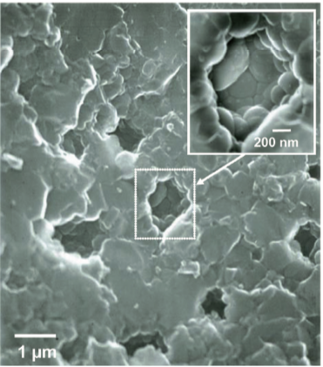
BISON model for pulverization
High-burnup structure in UO2
[Sonoda et al., NIMB, 2002].
Turnbull et al., Nuc. Sci. & Eng., 179,477 (2015).
Current model is empirical, based on burnup and temperature
Pulverization is predominantly observed to occur in regions where high-burnup structure (HBS) has partially or completely formed
HBS: Grain size decreases to ~150–200 nm, micron-sized bubbles form with multiple grains intersecting each bubble
Goal: Develop a physics-based criterion for pulverization in BISON that accounts for microstructure
Focus on HBS

Slide 31
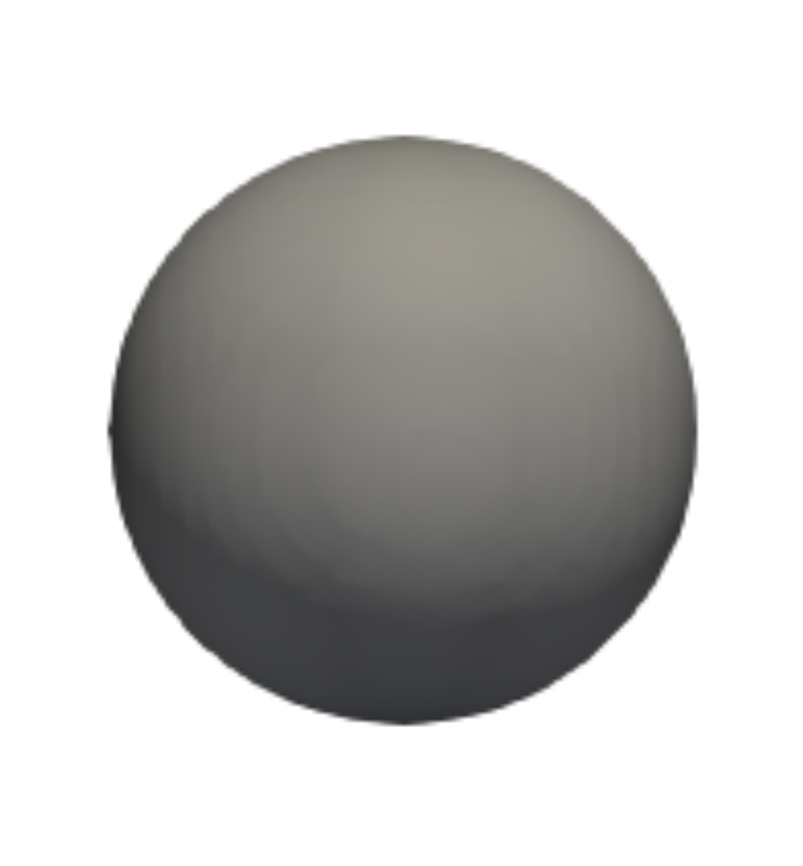
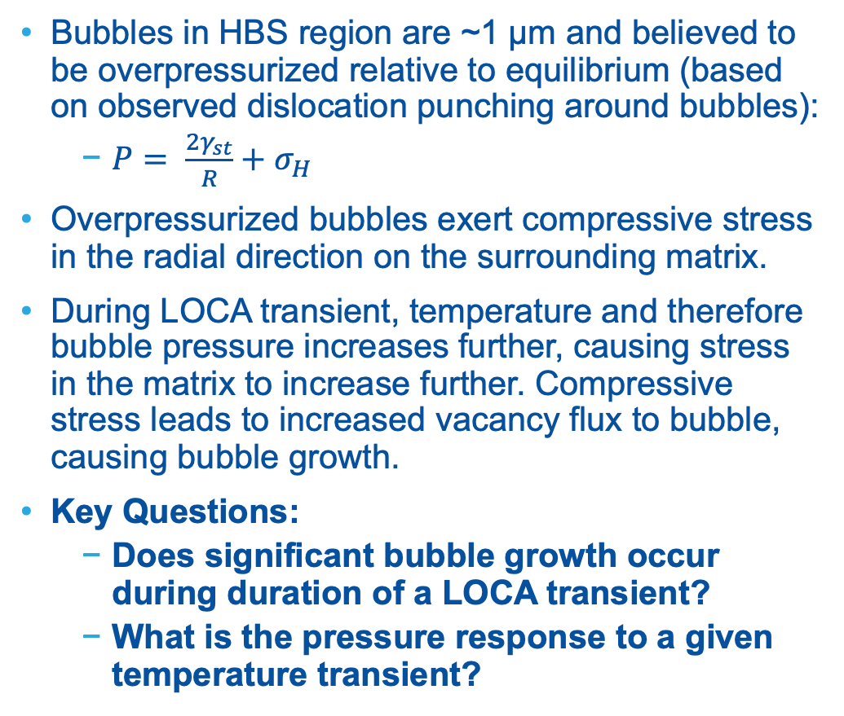
HBS bubble response to LOCA transient
Bubbles in HBS region are ~1 µm and believed to be overpressurized relative to equilibrium (based on observed dislocation punching around bubbles):
$P= \frac{2γ_{st}}{R}+σ_{H}$
Overpressurized bubbles exert compressive stress in the radial direction on the surrounding matrix.
During LOCA transient, temperature and therefore bubble pressure increases further, causing stress in the matrix to increase further. Compressive stress leads to increased vacancy flux to bubble, causing bubble growth.
Key Questions:
Does significant bubble growth occur during duration of a LOCA transient?
What is the pressure response to a given temperature transient?
Vacancy
Flux

Slide 32
Phase-field model: Essential physics
Single order parameter 𝜂 to represent gas bubble and fuel matrix phase
Current model does not consider grain boundaries
Track vacancies and fission product gas atoms
Use Xe properties for fission product gases
Source terms for production, sink term to limit vacancy concentration to steady-state
Chemical and elastic energy contributions
Solid-bubble interfacial energy
Kim-Kim-Suzuki (KKS) approach to remove bulk energy contribution to interfacial energy
Surface tension of bubble-matrix interface
Xe gas pressure
𝜂 = 0
𝜂 = 1

Slide 33
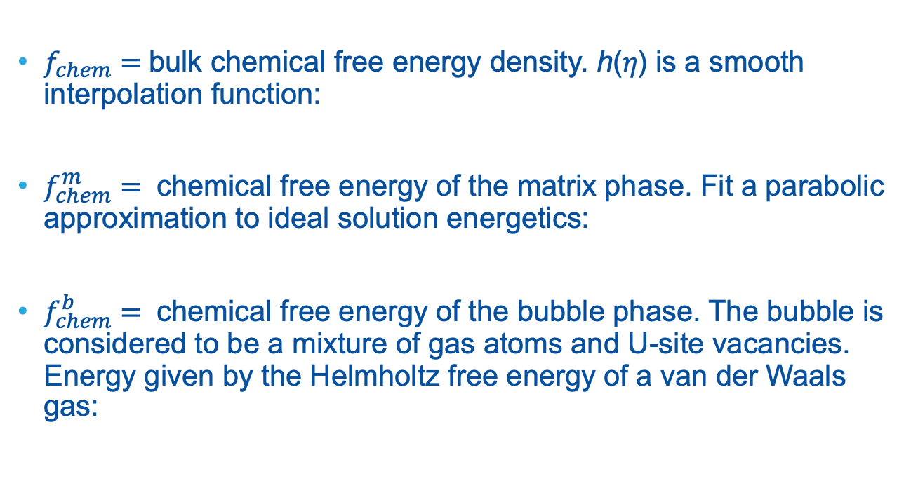
Phase-field model: Free energy functional
$f_{chem}=$bulk chemical free energy density. h(𝜂) is a smooth interpolation function:
$f_{chem}^{m}=$ chemical free energy of the matrix phase. Fit a parabolic approximation to ideal solution energetics:
$f_{chem}^{b}=$ chemical free energy of the bubble phase. The bubble is considered to be a mixture of gas atoms and U-site vacancies. Energy given by the Helmholtz free energy of a van der Waals gas:

Slide 34
Parameterization for Xe gas phase
Gibbs triangle: U lattice sites
Helmholtz free energy density: Van der Waals gas
Notes:
For the gas phase, we are treating it as a mixture of lattice site vacancies and Xe atoms
So if you think of a Gibbs triangle representation of the composition of the lattice sites, the gas phase sits along this edge, with pure vacancies on this corner and pure Xe on this corner
So if you confine yourself along this edge, the energy is given by the Helmholtz free energy of Xe, which we approximate as a VDW gas
So the free energy looks like an ideal gas and then starts to increase until you get to the point where all the volume is taken up by the hard sphere exclusion volume, and at that point the free energy shoots up to infinity
We found that the minimum in concentration corresponds to a pressure of 465 Mpa, which is close to the measured internal pressure of intragranular bubbles
So to make things tractable numerically, we approximated the free energy with a parabolic approximation about this minimum
\frac{F}{V} = c_g n_U kT \left[ \ln{ \left( \frac{1}{n_Q \left( \frac{1}{c_g n_U - b}\right)} \right) } - 1 \right]
Will need a slide explaining these terms further

Slide 35
Phase-field model: Elastic energy
Interpolating elastic energies and stresses (Voigt-Taylor scheme):
Mechanical equilibrium equation:
Eigenstrain due to vacancies:
Bubble pressure:
Surface tension:

Slide 36
Evolution equations
Allen-Cahn for order parameter:
Cahn-Hilliard for vacancy and gas concentration (source for vacancies and gas atoms, sink for vacancies to approximate recombination):
Mobilities are a function of defect diffusivities:
+ KKS system constraints

Slide 37
Phase-field model verification and testing
Considered stress state in equilibrium, underpressurized, overpressurized bubbles (1D simulation in radial coordinates)
Equilibrium: 𝜎_{rr} = 0 in surrounding solid matrix
Under/overpressurized: 𝜎_{rr} = +/-, corresponding to tensile/compressive stress in surrounding matrix
Converge to analytical solution as interface width ($2λ$) decreases
Bubble
Matrix
Bubble
Matrix
Bubble
Matrix
Underpressurized
Equilibrium
Overpressurized

Slide 38
Bubble growth during steady-state operation
Assume bubble pressure is 100 MPa in initial conditions
Upper bound based on dislocation punching pressure
Bubble pressure decreases during growth but remains well above equilibrium pressure
Increased likelihood of fragmentation during LOCA

Slide 39
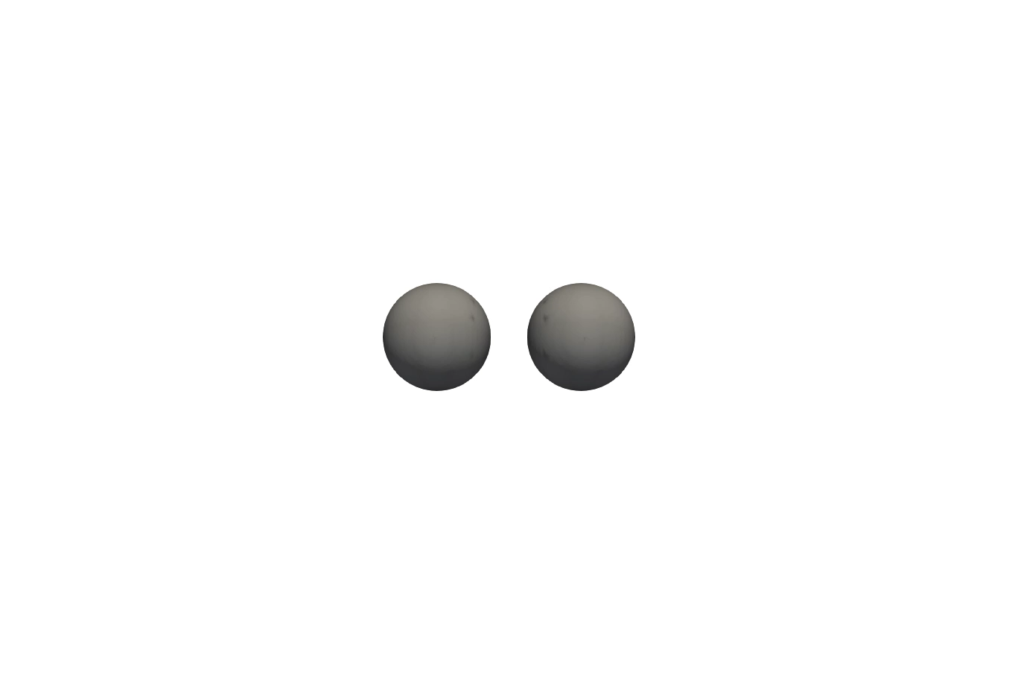
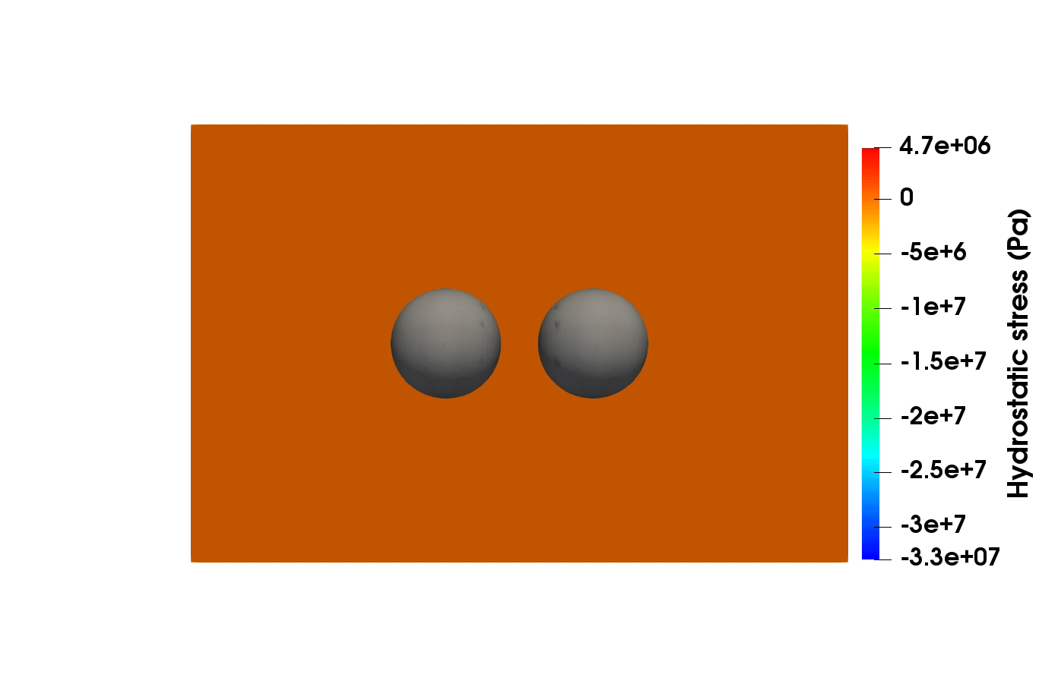
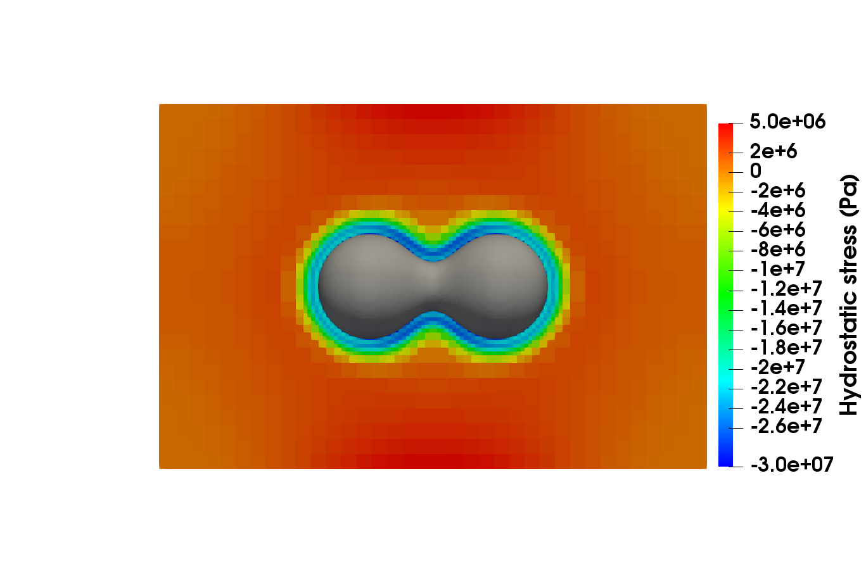
Bubble growth during steady-state operation
3D simulation to 1.5 × 10⁷ s, 2 bubble impingement, initial radii of 300 nm
Hydrostatic stress surrounding bubbles
Region of enhanced compressive hydrostatic stress in “neck”
t = 1.3 × 10⁶ s

Slide 40
Bubble response during LOCA transient
Temperature ramp from 700 to 1400 K at 5 K/s
Consider fixed bubble radius of 250 nm in initial conditions
Maximum initial pressure set to P₀ = 200 MPa (upper bound based on dislocation punching); vary P₀ for fixed bubble size
No significant change in bubble radius for each case

Slide 41
Bubble response during LOCA transient
Vary initial radius: 250 nm, 500 nm, 1000 nm
Change domain size to maintain 10% porosity
Initial pressures set at upper bound estimate from dislocation punching: 200, 100, 50 MPa.
No significant change in bubble size

Slide 42
Bubble response during LOCA transient
Vary external pressure at simulation domain boundary, P_{ext}, for constant bubble R = 500 and P₀ = 100 MPa
No significant size change; pressure transient unchanged
P_{ext} may have a stronger impact on fracture behavior

Slide 43
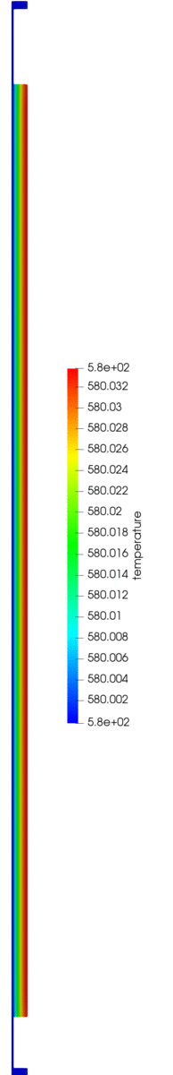
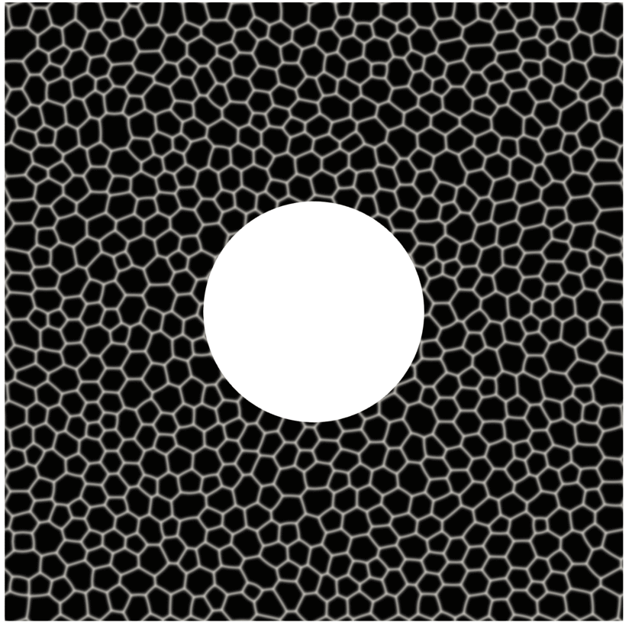
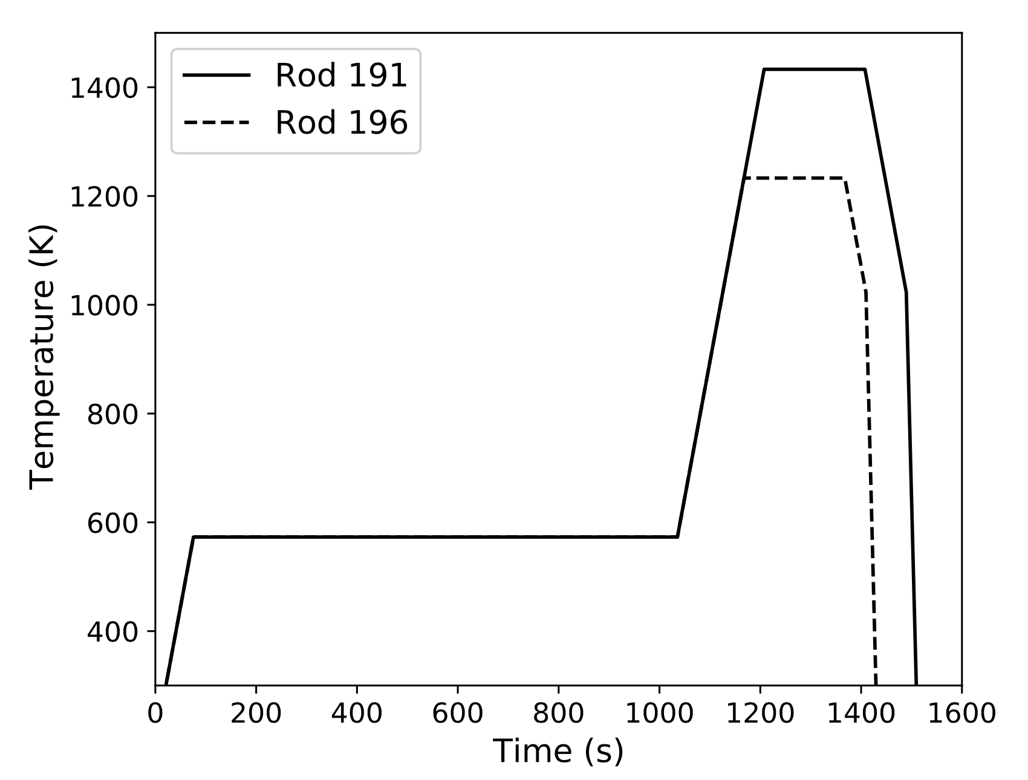
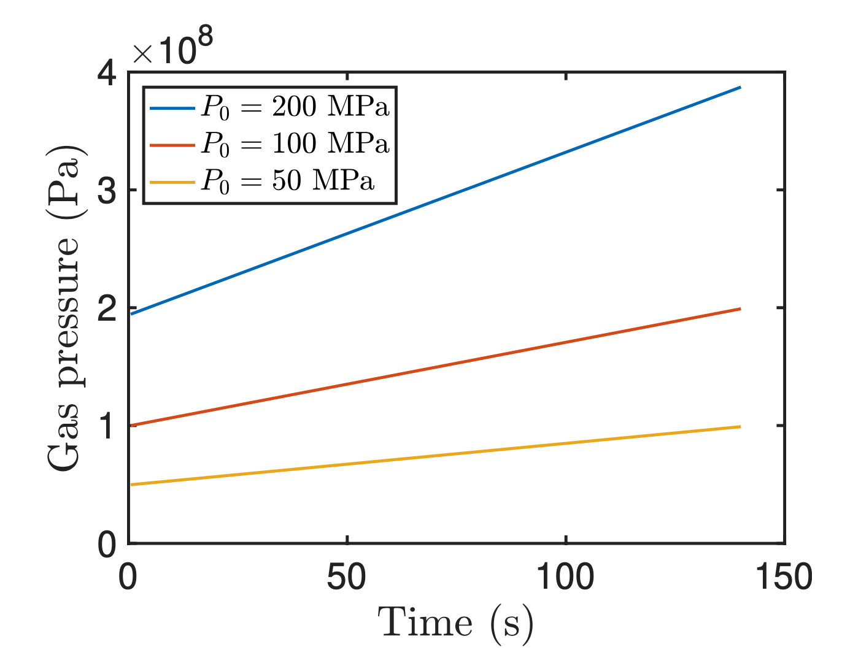
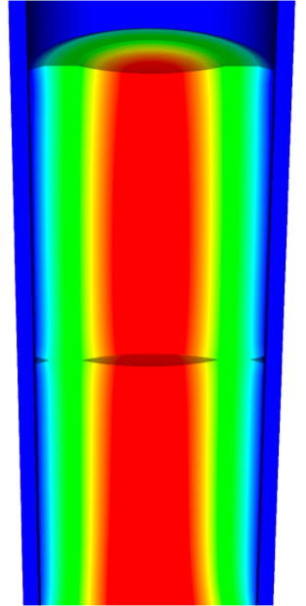
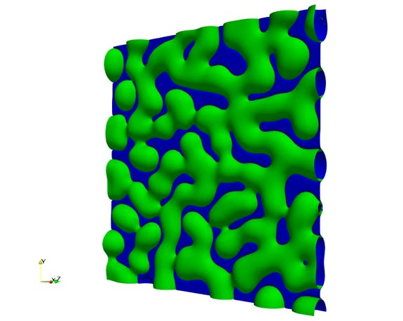



Modeling fragmentation in high-burnup UO₂ using phase-field fracture
Temperature
Pressure
Notes:
We started to investigate gas-pressure-induced fracture behavior during LOCA-driven temperature tran- sients. During a LOCA transient, temperatures in the fuel rod increase rapidly, leading to increased pressure in the gas contained within the bubbles. The temperature as a function of time at the edge of a represen- tative pellet for each rod was obtained by using the engineering-scale fuel performance code BISON [35] simulation of the Studsvik Rod 196 experiment [36]. The temperature was used as an input to the Kim- Kim-Suzuki phase-field model [37] to determine the pressure as a function of time. In the Kim-Kim-Suzuki phase-field model, the gas pressure is assumed to be 100 MPa during steady-state reactor operation at 700 K. The Studsvik experiment was begun with a fixed temperature hold at 572.6 K at the outer surface prior to the transient, resulting in the initial pressure at the start of the transient decreasing from 100 MPa to below 80 MPa. The pressure was passed to our phase-field fracture model to simulate fracture in the regions surrounding individual bubbles.
The size of the bubble did not change significantly during the transient for a variety of initial conditions, including varying bubble size, initial pressure, and external restraint pressure. a phase-field fracture model to inves- tigate fracture in response to LOCA transients does not need to account for a change in bubble size, thus simplifying the model required for that work.

Slide 44
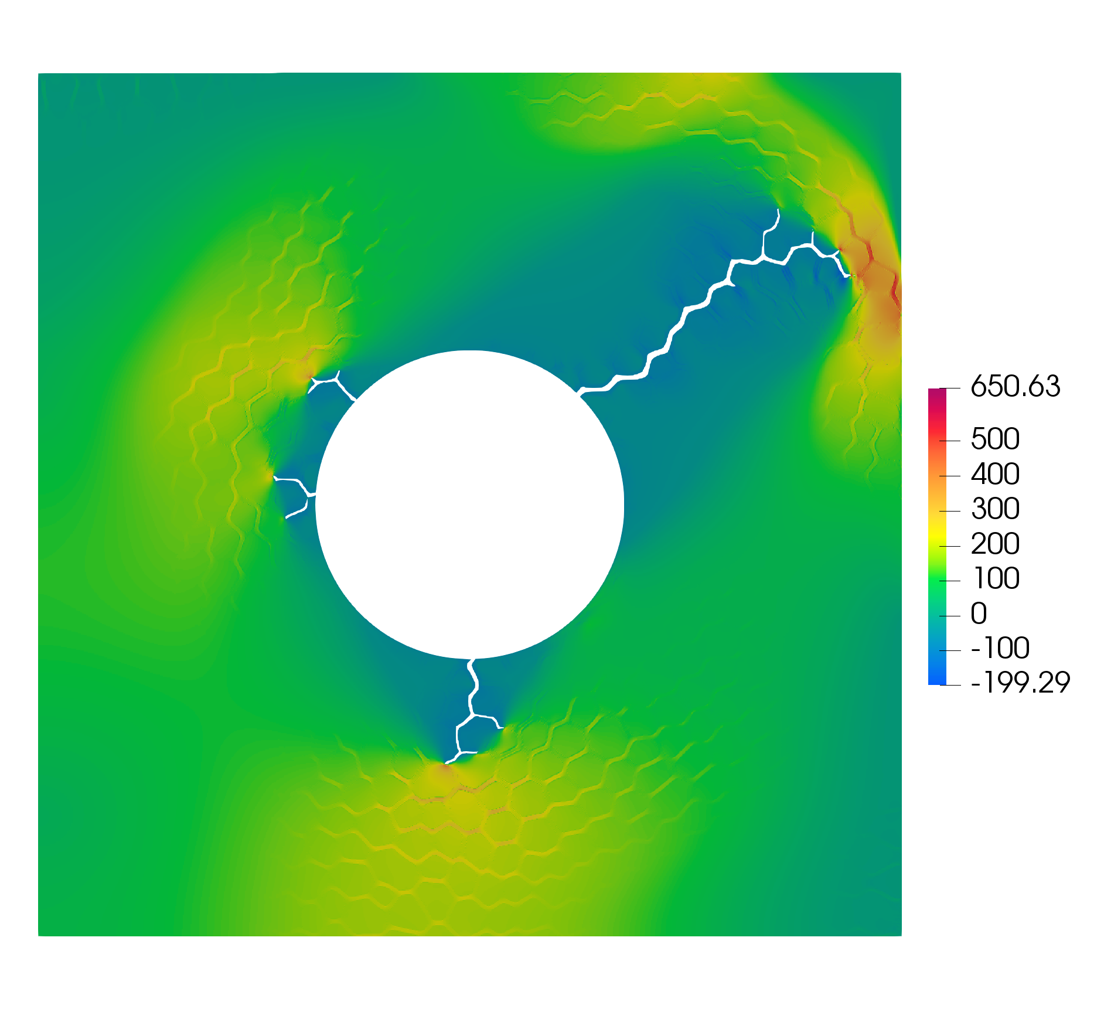
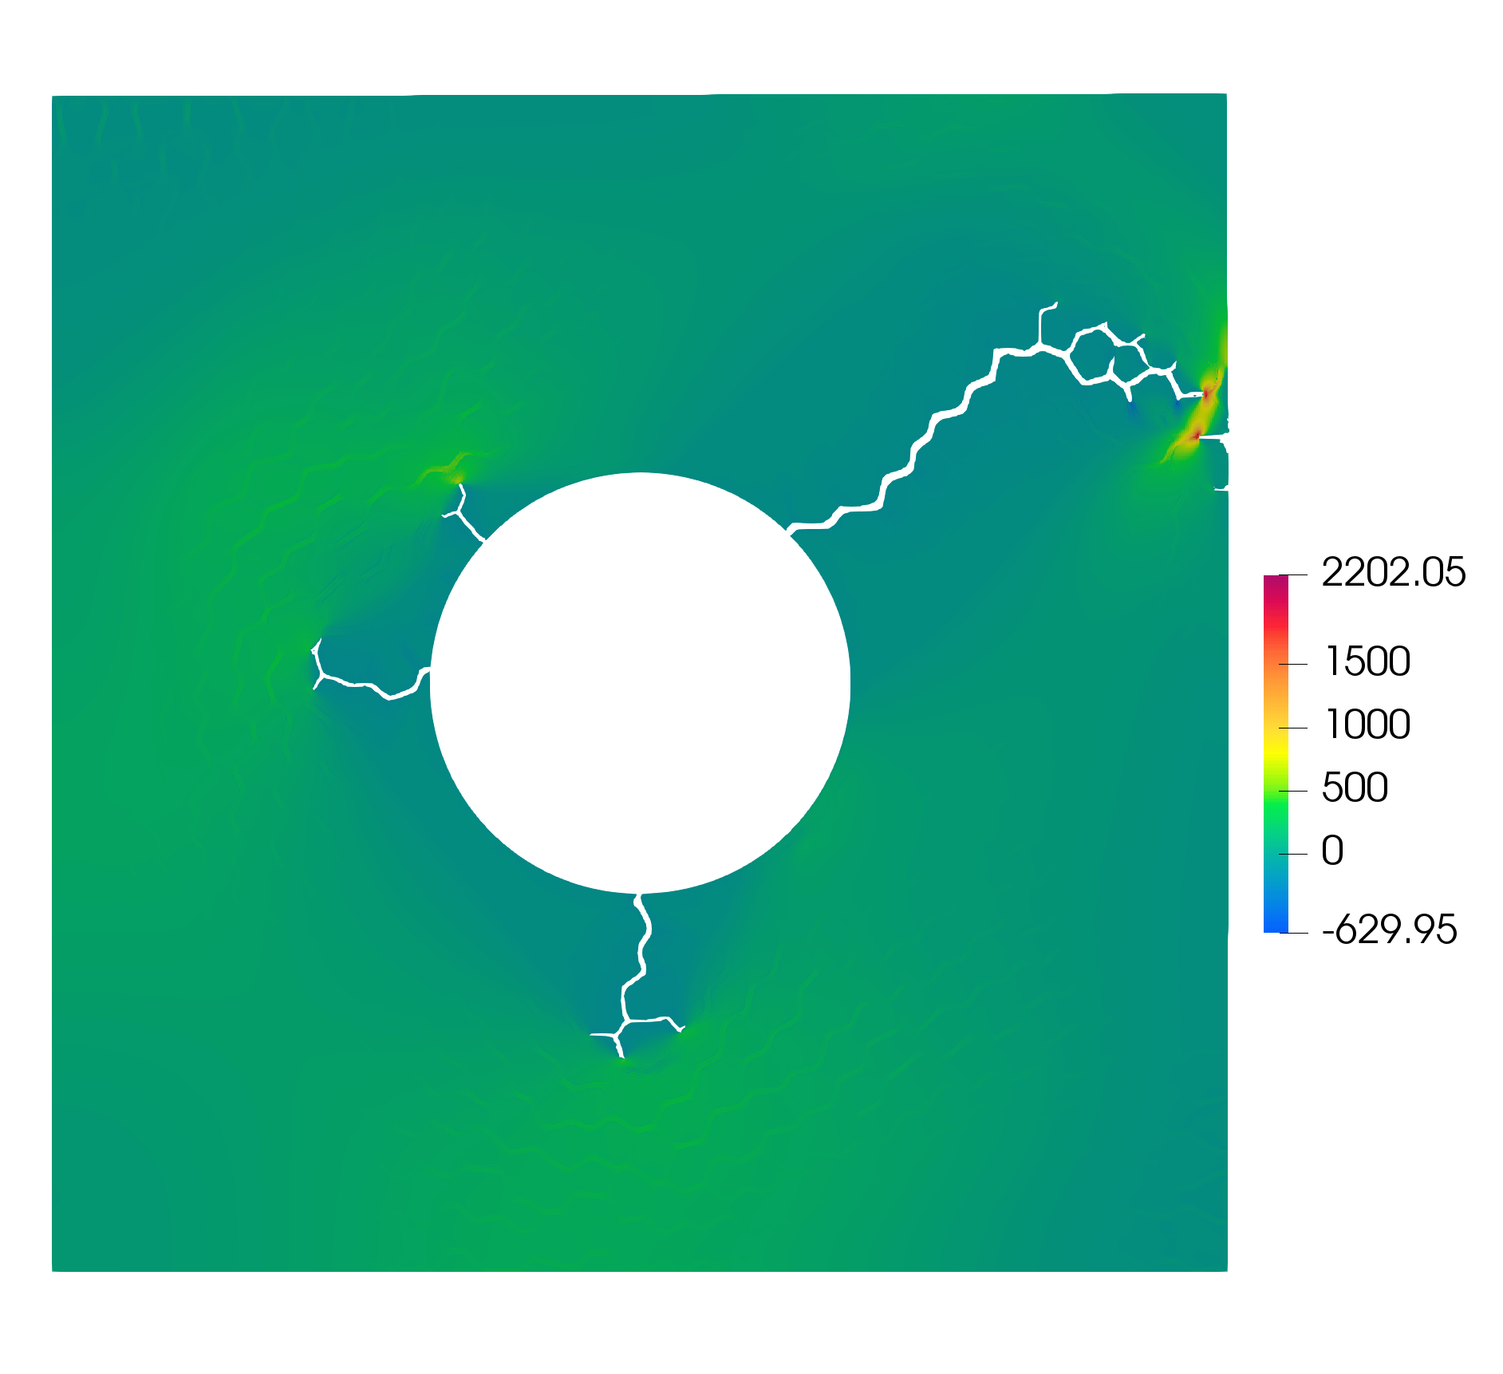
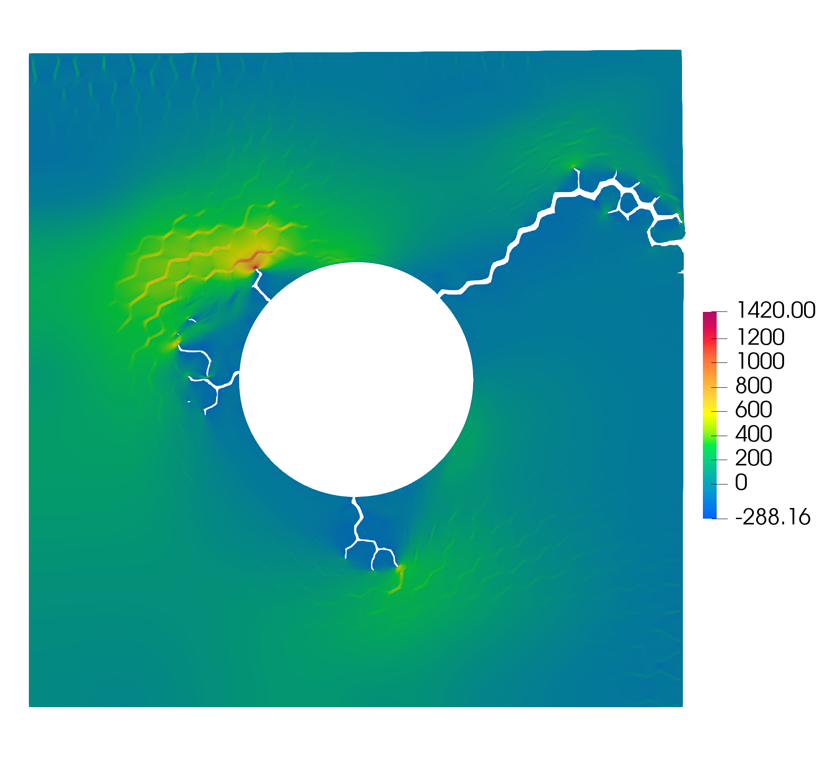
External pressure
External restraint pressure significantly affects the gas pressure at which fracture occurs
External pressure = 0 MPa
External pressure = 30 MPa
External pressure = 60 MPa
Notes:
o study the effect of external pressure, different external pressures were then applied on the top and right boundaries. In a fuel pellet, such external pressures can be caused by the fuel-cladding mechanical interaction. The results from using three different external pressures—0, 30, and 60 MPa—are shown in Figs 9, 10, and 11, respectively. The external pressure can alter the critical pressure, as it plays a role in compressing the bubble. The critical pressure becomes significantly higher for larger external pressure values, though the crack pattern does not significantly change.
Some tests showed that the pulverization and the fission gas release that it brings about can be substantially reduced if the fuel material is subject to hydrostatic pressure. The reviewed data suggest that a pressure of about 50 MPa is sufficient to suppress pulverization, which means that constraint from pellet-cladding mechanical interaction (PCMI) may limit pulverization and transient FGR in high burnup LWR fuel rods

Slide 45
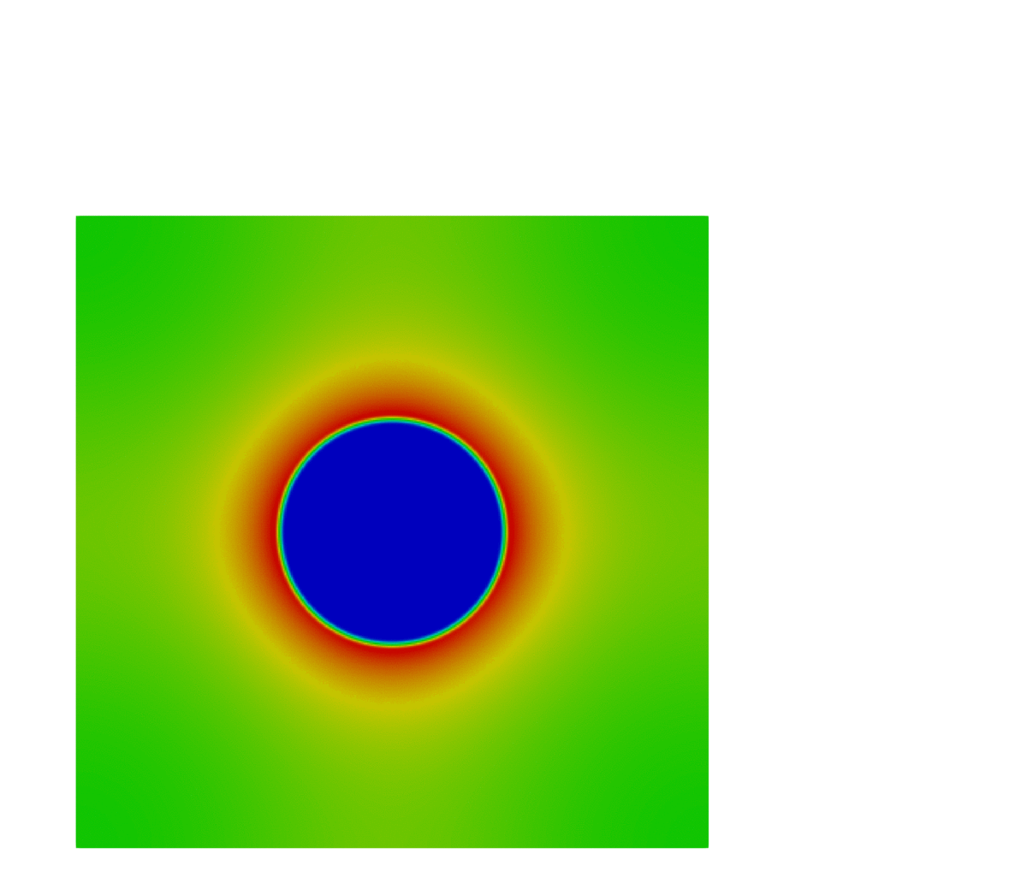
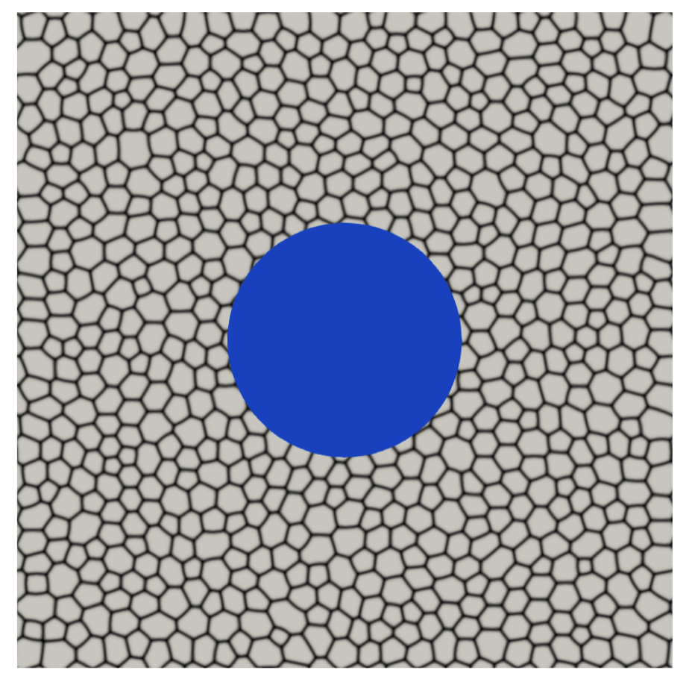
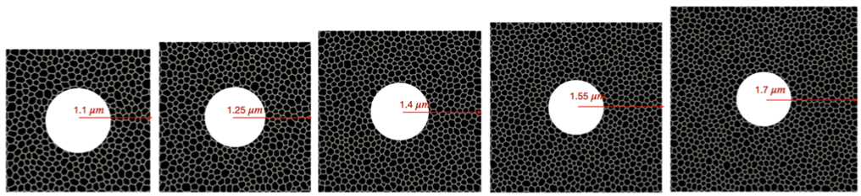
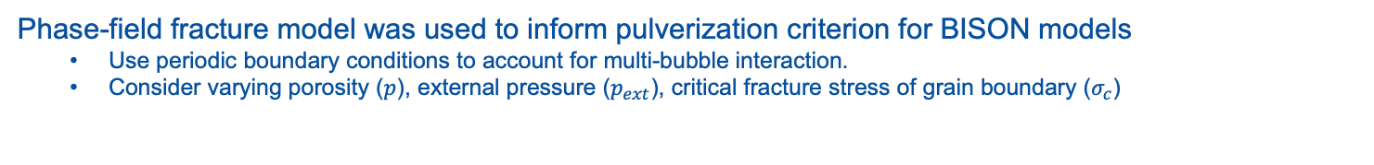
Determine BISON pulverization criterion based on phase-field modeling
Phase-field fracture model was used to inform pulverization criterion for BISON models
Use periodic boundary conditions to account for multi-bubble interaction.
Consider varying porosity ($p$), external pressure ($p_{ext}$), critical fracture stress of grain boundary ($σ_{c}$)
Notes:
Size of bubble?
Initial pressure?
GB strength?
What do colors mean in GIF?

Slide 46
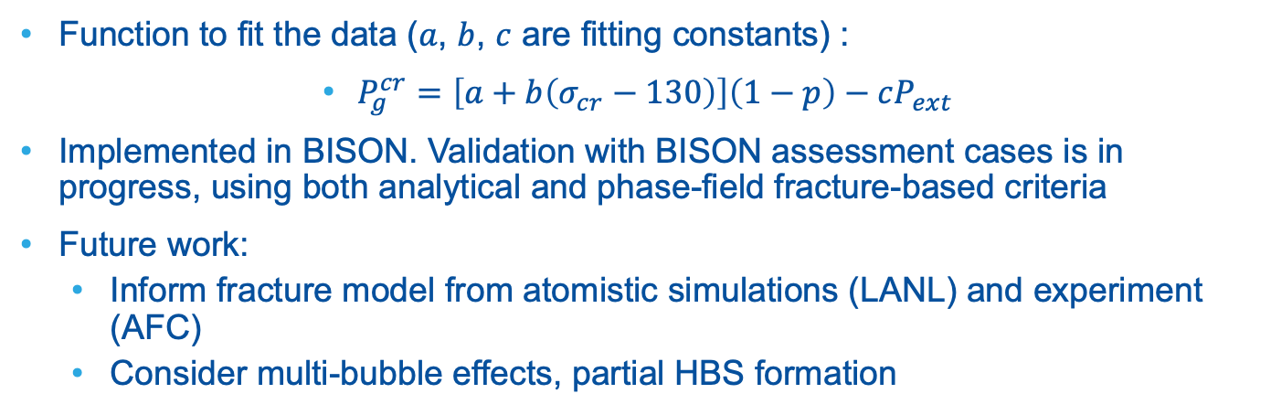
BISON pulverization criterion
Function to fit the data ($a$, $b$, $c$ are fitting constants) :
$P_{g}^{cr}=\left[a+b\left(σ_{cr}−130\right)\right]\left(1−p\right)−cP_{ext}$
Implemented in BISON. Validation with BISON assessment cases is in progress, using both analytical and phase-field fracture-based criteria
Future work:
Inform fracture model from atomistic simulations (LANL) and experiment (AFC)
Consider multi-bubble effects, partial HBS formation

Slide 47
Conclusions: High-burnup UO2 response to LOCA transients
Developed new phase-field model that accounts for effects of surface tension and gas bubble pressure to understand non-equilibrium bubbles
Bubble size did not change significantly during LOCA transients
Pressure as a function of time determined for given transients and passed to phase-field fracture model
Developed pulverization criterion in BISON
Validation of pulverization criterion by comparison with existing experimental data is in progress

Slide 48
Thank you!
Funding Support: DOE-NE NEAMS Program
Questions?

Slide 49
Volume fraction of bubble phase
High M: Volume fraction increases more quickly as defect species is carried from solid to bubbles more quickly
Notes:
This shows the Vf of the bubble phase versus time
So if you look in the early stages there is some difference between the cases with different mobility
So in the early stages, when the mobility is high and the bubbles are still pretty far apart, that high mobility can carry the defect species from the solid to the bubble faster
So Vf increase more quickly
However when the volume fraction of bubbles gets higher, the fraction of the solid phase gets lower so the defect species don’t have to diffuse as far
So that’s why later the lower diffusivity case can catch up, and by the time at the end of the movies the Vf is pretty much the same. So that’s not a significant reason for the different morphologies in the high diff and low diff cases

Slide 50
Surface area of interface
Mobility changes morphology
Competition between source term growth (increases surface area) and coarsening (reduces surface area)
High mobility case: Coarsening is accelerated, reducing surface area as growing bubbles begin to interact with each other
Notes:
So another way to quantify the microstructure is by looking at the area of the interface
Shown versus time on left and versus porosity on right
So what we’re seeing is that there’s a competition between the growth caused by the source term, which wants to increase surface area, and the coarsening, which is the process by which the system tries to reduce its surface area in order to reduce interfacial energy
When the mobility is high, that increases the rate at which coarsening happens so we end up with a smaller surface area for the high mobility case
However this only starts to happen in the later stages when the bubbles begin to interact with each other

Slide 51
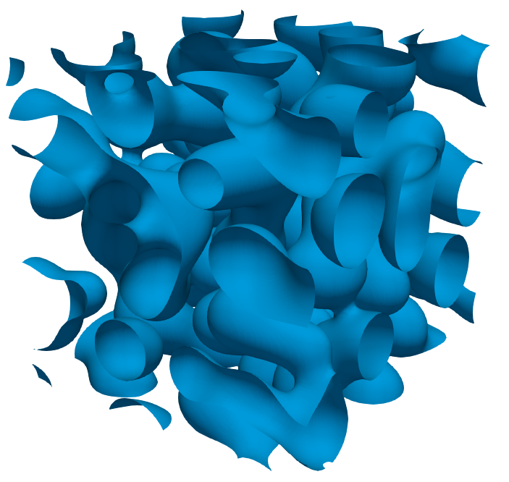
Length scale/feature size
Would like to have simulation domain size >> length scale throughout
How to measure?
Bubble radius is convenient in early stages but loses meaning when a highly interconnected microstructure forms
Alternative: Inverse of surface area per unit volume of bubble phase, 1/S_{v}
Used for coarsening in past
1/S_{v} remains at least an order of magnitude < domain size (72 μm) throughout
Notes:
Another aspect of the microstructure we’d like to characterize is the length scale or the characteristic size of features in the system
The reason for this is that to improve our statistics, we’d like to make sure we have a simulation domain that’s significantly larger than the characteristic size of features in the system for the entire simulation
So how can we measure this? It’s easy early in the system’s evolution when the bubbles are isolated spheres and we can use their radius, but later on when most of the bubbles join up and a highly interconnected microstructure forms the radius doesn’t really apply any longer
So an alternative metric for length scale that was developed to look at the coarsening of bicontinuous structures is the inverse of the surface area per unit volume of the bubble phase
So if we plot that throughout the simulation we see that although it does grow quite a lot compared with the initial conditions, it’s still more than an order of magnitude lower than the simulation domain size of 72 microns, which increases our confidence that we’re using a simulation domain size large enough to get reasonable statistics

Slide 52
Effect of minimum bubble spacing in initial conditions
Also simulated l_{min} = 130 nm, 200 nm, 5 configurations each
200 nm: Initial portion of release curve delayed
Slight decrease in F_{c,sat} with l_{min}, but may be just due to statistical variation
Min. spacing (l_{min}), nm | F_{c,sat}
130 | 0.61 ± 0.039
160 | 0.60 ± 0.036
200 | 0.58 ± 0.046
Notes:
I mentioned before that there is a minimum spacing between bubbles in the Ics
This is not something we can get from the rate theory model
It’s likely a function of the nucleation barrier to form a new bubble as well as the diffusion coefficients that control the size of the depletion region of gas atoms and vacancies surrounding an existing bubble, So we wanted to try to at least see what the impact of this parameter is, so we varied in range 130 – 200 nm and simulated 5 total configurations for each spacing
Qualitatively, we found the largest spacing delayed the early stages of venting and increased the rate of venting once it did begin as the bubbles in the IC start farther apart from each other so few connect to the boundaries in the early stages, then connect more rapidly on
For the smaller initial spacing, Fc,sat is increased so gas release is delayed
What’s happening here is that you get several collections of bubbles that link up in the interior but they might be farther to a bubbles that connects them to an edge so several large bubbles connect later in the growth stages
So looking at the mean values calculated from the 5 different configurations, there is a slight decrease in Fc,sat which is in agreement with the qualitative trends I just mentioned, but the difference between the Fc,sat for the minimum and max spacing is smaller than the std dev for any of these individual values, so what looks like a trend may just be the result of statistical variation

Slide 53
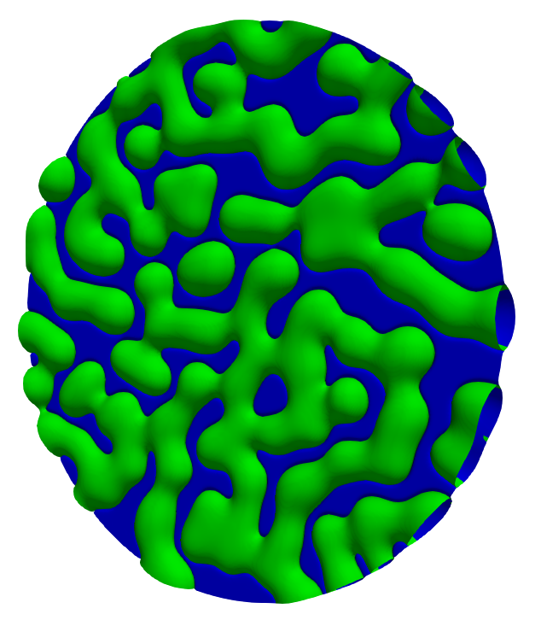
Effect of simulation domain geometry
Compare venting curves for circular GB vs. square GB
Circular GB: F_{c,sat} = 0.61 ± 0.046, Square GB: 0.60 ± 0.036
Conclude that GB geometry does not have a significant effect
Notes:
Another simulation assumption we wanted to consider was the simulation domain geometry
As I mentioned earlier we started looking at square grain boundaries, but the average grain will have more than 5 edges
GBs with different number of edges have different perimeter length for the same areas
So we decided just to look at the extreme case of a circular vs. square GB with same area
We looked at 5 different configurations for the circular GB with the same parameters including minimum spacing
We found that the mean calculated Fc,sat was 0.61 which is within the estimated uncertainty of the result for the square GB
So based on this, we conclude that the GB geometry doesn’t have a significant effect

Slide 54
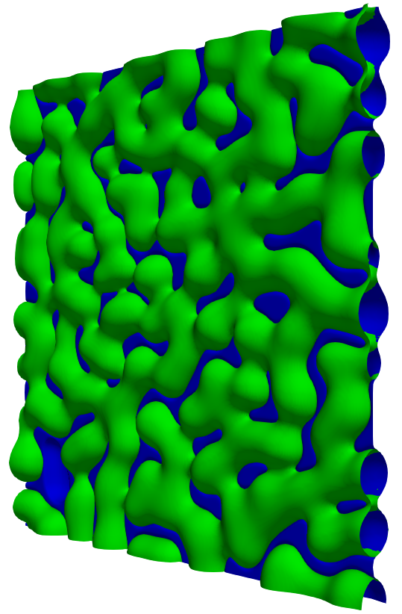
Effect of simulation temperature
Current BISON model assumes F_{c,sat} is independent of temperature
Primary effect of varying temperature: Gas diffusivity D_{g}
Ran 5 simulations with T = 1015 K (D_{g} decreased by 2x)
Much finer microstructure at same simulation time
No change in calculated F_{c,sat} = 0.60 ± 0.014
Microstructure at t = 1.98 × 10⁸ s:
D_{g} = 0.05 nm²/s
D_{g} = 0.1 nm²/s
Notes:
The final simulation assumption I’ll talk about is the effect of the simulation temp.
The Bison model currently assumes that Fc,sat is indep of temperature
So we wanted to investigate whether this was a valid assumption
So if you look at how temperature affects all the parameters used in the model, it really only significantly affects the gas diffusivity
So we ran a set of simulations at lower temperature, 1015 K instead of 1035 K, which decreased the gas diffusivity by a factor of 2
So if you compare the microstructure at the same simulation time, you see that the change in diffusivity does have a pretty strong impact on the microstructure
You have a much finer microstructure with many more points of interconnection for the lower diffusivity
However, in spite of the change to the microstructure, if you calculate Fc,sat from this set of simulations you get the same value
So from this, we can say that over the range of temperatures we looked at there wasn’t a strong impact of the diffusion coefficient, but I do want to add the caveat that this is over a pretty limited spread of temperature. We did want to look a lower temperatures but model limitations prevented us from considering temperatures lower than that

